Slide 1
Up Now: Bill Poirier
Up next: Millard Alexander

Slide 2
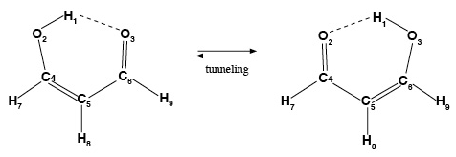
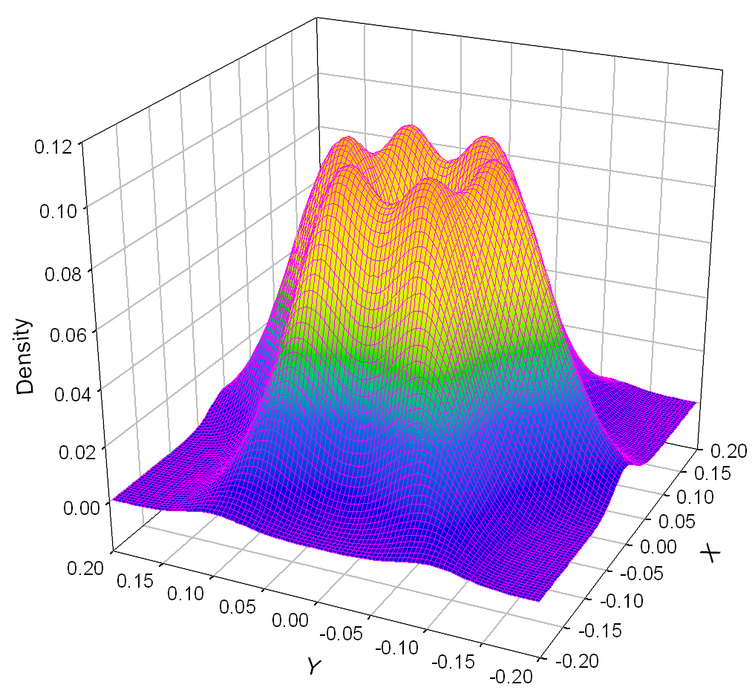
Massively Parallel Quantum Dynamics Codes
Bill Poirier, Texas Tech University
Project Outcome: The goal of this research project is to effectively parallelize accurate quantum dynamics calculations across the next generation of massively parallel supercomputers. Previous work by the Poirier group and others has achieved massive parallelization for model systems, but only very modest parallelization for real molecular applications. Very recently, under NSF CHE-1012662 support, the Poirier group achieved a parallel speedup of 976x, across 1140 computer cores (85.6% parallel efficiency), for a quantum dynamical calculation of the HO₂ molecule. What used to take months of computer time can now be done in minutes.
Harmonic Model
Malonaldehyde
Cluster and System size
HO₂
Neon Trimer
Impact & Benefits: Molecular simulations enable computers to replace expensive, difficult, and time-consuming laboratory experiments, and are thus routinely used in many important application areas (e.g., energy, drug design, nanomaterials, etc). However, very few of these calculations incorporate quantum dynamical effects, even though these are often very important, and so the results are not always reliable. Research related to the above project outcome could thus dramatically improve the accuracy, reliability and true predictive power of molecular simulations, which could help lead to major breakthroughs in the many areas where such simulations are used.
Realistic Molecular Application
Background & Explanation: Poirier and collaborators have been developing accurate, efficient quantum dynamics algorithms for 18 years, with the recent emphasis being massive parallelization. This is extremely challenging work, but necessary, because quantum calculations require enormous computational effort. Parallelization across ~1000 cores thus constitutes a ground-breaking advance. The codes will be made available to other scientists. Training will also be provided, using the TTU Chemistry Computation Cluster (CCC), recently funded under a related NSF CRIF MU grant (CHE-0840493). The calculations discussed here were performed on the CCC, the TTU HPCC cluster, and LoneStar (Texas Advanced Computing Center).
Advances in accurate quantum dynamical calculations for larger molecular systems will require effective parallelization across increasingly large computing clusters. Massive parallelization has been achieved for model systems (vertical axis) but until recently, not for real molecular applications (horizontal axis). Recently, the Poirier group has effectively parallelized the neon trimer application across 96 cores, and the HO₂ application across 1140 cores. These are important milestones on the way towards much larger and more realistic molecular applications, e.g. tunneling in malonaldehyde, whose quantum dynamical calculation is a goal of this research project.

Slide 3
Up Now: Millard Alexander
Up next: Veronica Vaida

Slide 4
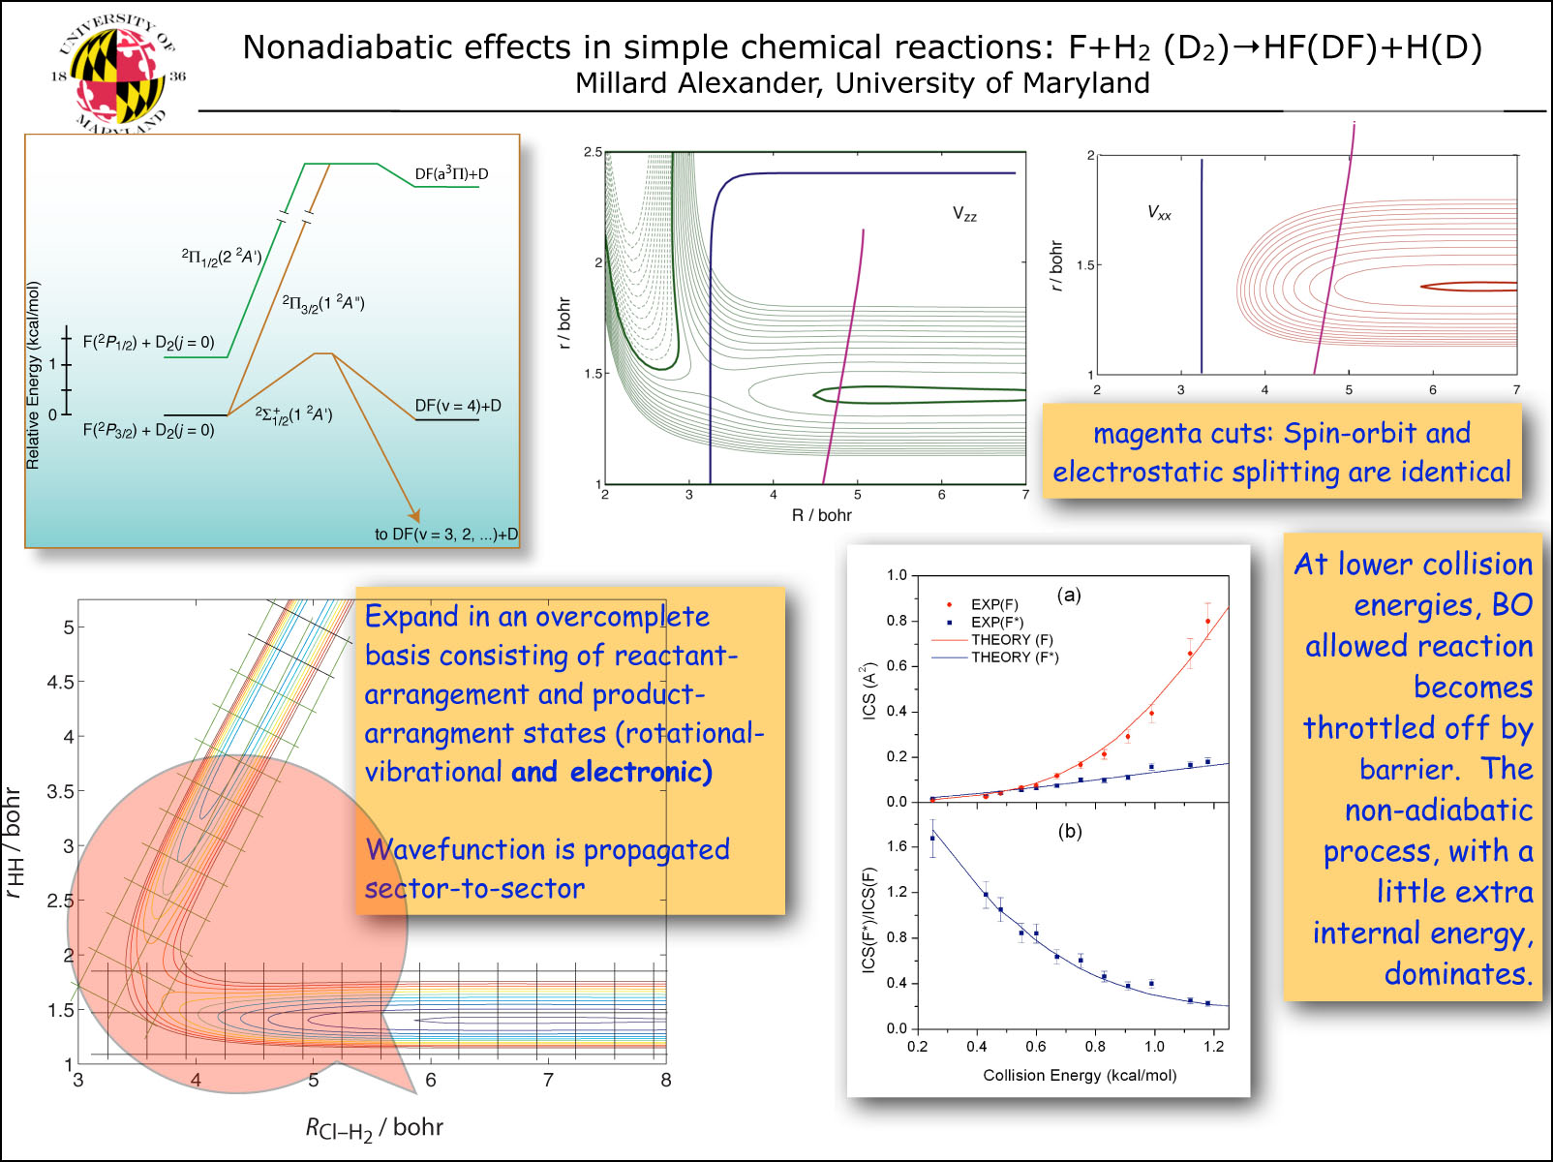

Slide 5
Up Now: Veronica Vaida
Up next: Hua Guo

Slide 6
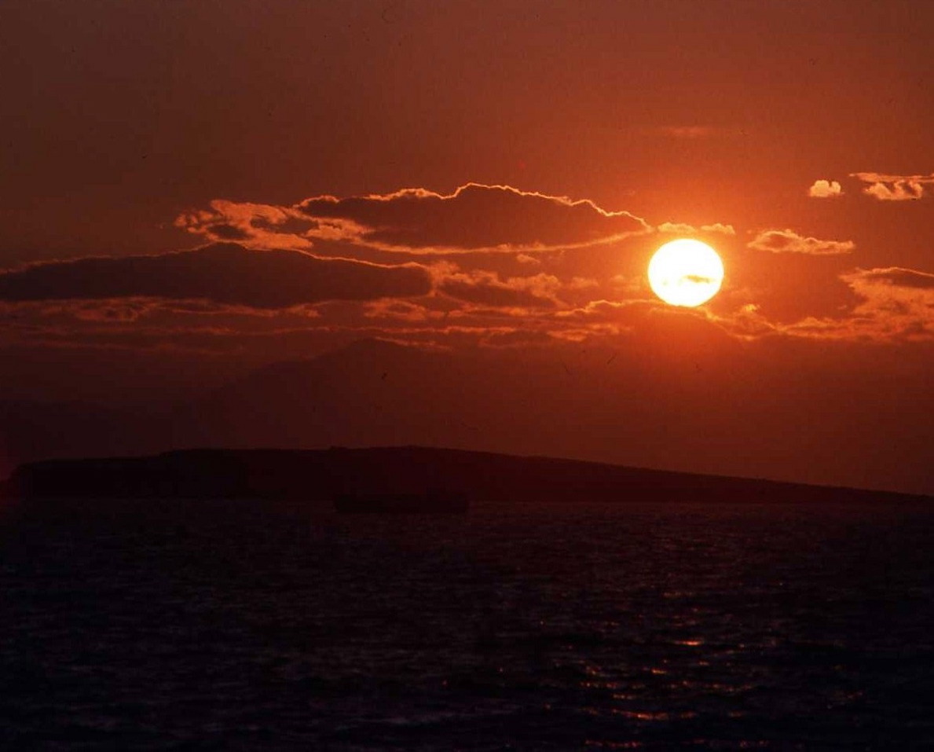
SUNLIGHT INITIATED CHEMISTRY OF SULFUR COMPONDS
Experiments – Vaida group (spectroscopy based on cavity enhanced methods) to investigate light initiated reactions.
Theory – Skodje group- to explore the dynamics of thermal and light initiated reactions as affected by water
Isotope enrichment due to photolysis of oxidized (SO₂, SO₃, H₂SO₄) and reduced sulfur compounds: electronic (UV) and vibrational (red) states. Initial studies: SO₂.H₂O and H₂SO₄.H₂O
Effect of the environment on photochemistry (surfaces, condensed phase). Enhanced cross sections for absorption.
Water mediated reactions
Catalysis and anticatalysis of thermal and light initiated (non-thermal) reactions by water (complexes, water-air interfaces)

Slide 7
Up Now: Hua Guo
Up next: Matt Johnson

Slide 8
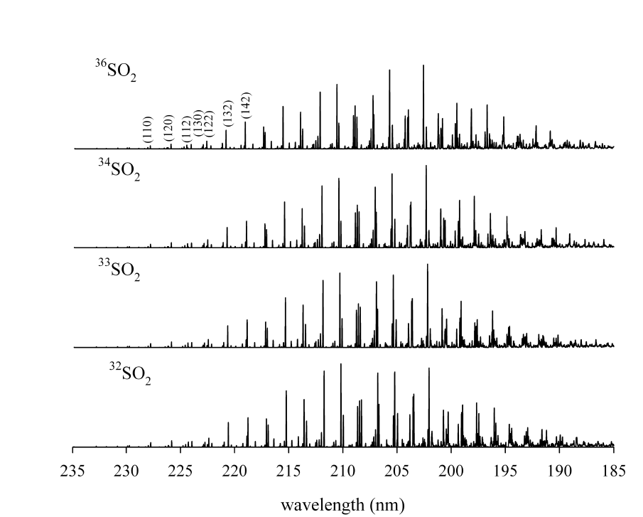
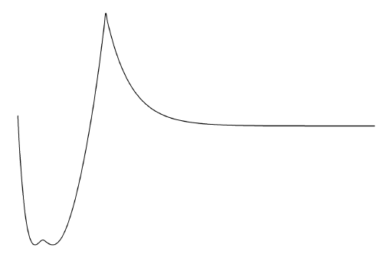
SO₂ photodissociation
predissociation
SO + O
SO₂(C¹B₂)
Ran, Xie, Guo, CPL 2007
Tokue, Nanbu, JCP 2010
hv
S-MIF
*Exp: Farquhar et al, 2001, MIF in elemental S
*Theo: photodiossociation/self-shielding (Lyons, 2007), but what about subsequent reactions (pressure dependence, Masterson et al. 2011)?

Slide 9
Up Now: Matt Johnson
Up next: Jim Lyons

Slide 10
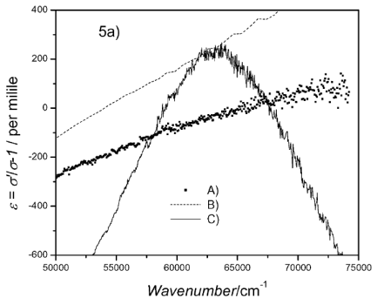
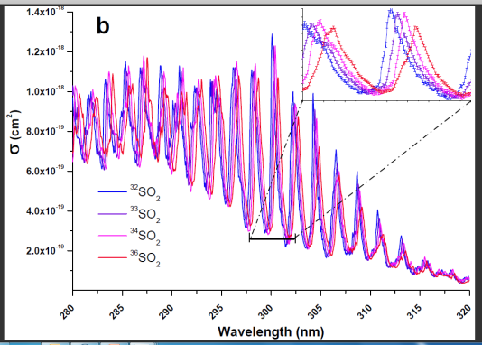
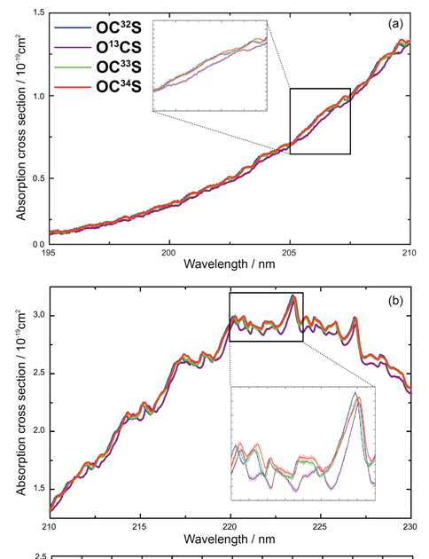
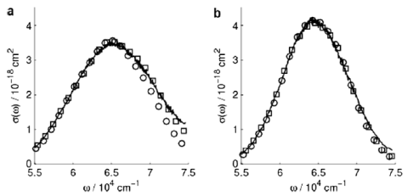
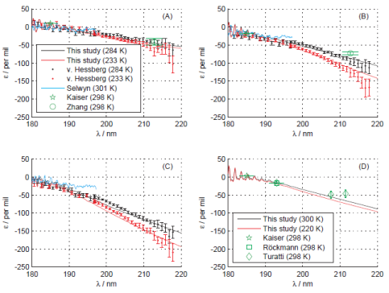
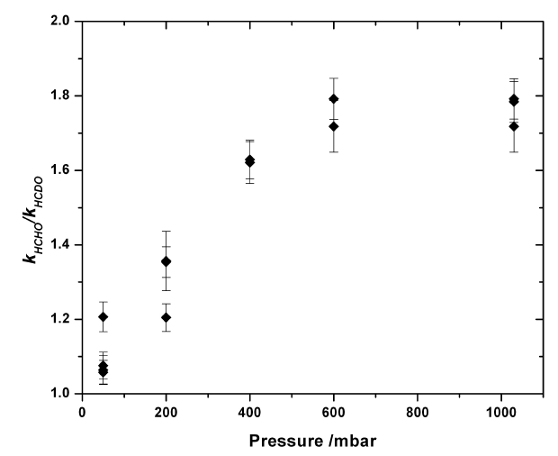
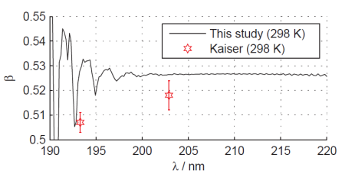
Key conclusions from experimental and theoretical studies of isotopic fractionation in photolysis
Matthew S. Johnson, msj@kiku.dk
Department of Chemistry, University of Copenhagen, Denmark
HCl/DCl
SO₂
OCS
Wavepacket propagation theory vs. experiment
ZPE
Reflection
Experiment
HCl
DCl
Grage et al., HCl and Cl, PCCP, 8, 4798, 2006.
J. A. Schmidt et al., HCl cross section, CPL, 480, 168, 2009.
N₂O
Danielache et al., manuscript, 2011.
N2O
¹⁵N¹⁴N¹⁶O
¹⁴N¹⁵N¹⁶O
1. The ZPE theory is usually wrong, even for the simplest systems.
2. Wavepackets work well when there is a good potential energy surface.
3. The gold standard is careful experiments using labelled samples
4. Mechanism matters to the temperature, pressure and wavelength dependence of isotopic fractionation
¹⁵N¹⁵N¹⁶O
¹⁴N¹⁴N¹⁸O
Hattori et al., manuscript, 2011.
HCDO
Three-isotope exponent spectrum
J. A. Schmidt et al., N₂O, ACP, in press 2011.
Nilsson et al., ACP 10, 3455, 2010.

Slide 11
Up Now: Trevor Sears
Up next: Jim Lyons

Slide 12

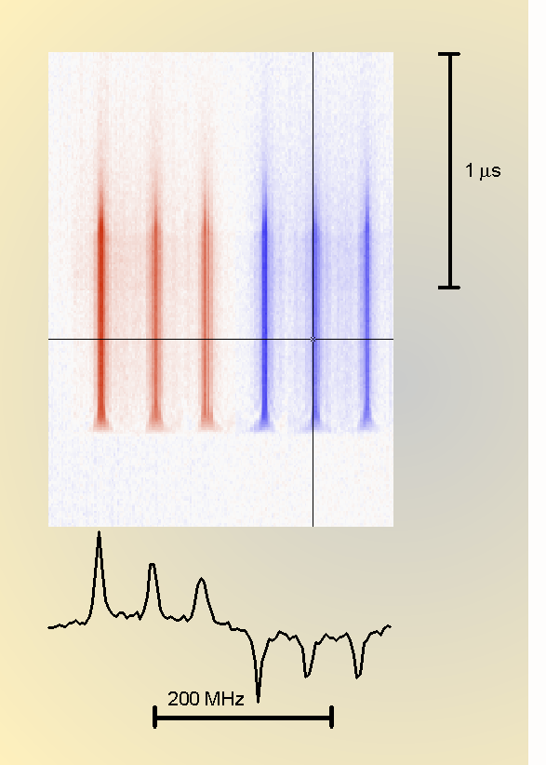
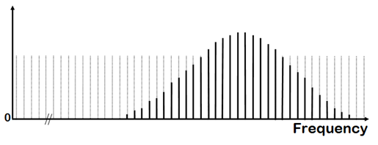
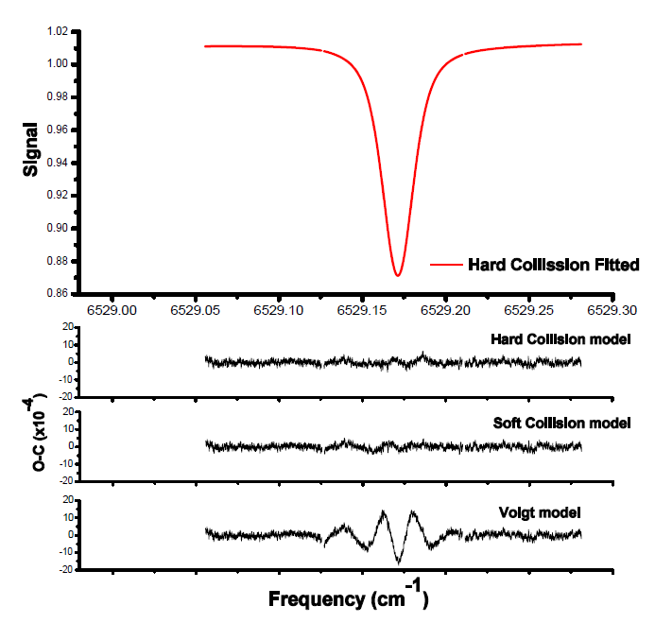
High Resolution Spectroscopy and Dynamics
Trevor Sears
Transient frequency-modulated laser absorption
High sensitivity and specificity, Doppler and sub-Doppler
Time resolution for collisional studies of transients
Frequency comb-based spectroscopy
Extreme precision and accuracy (2 in 10¹²)
Line positions and line shapes for calibration of remote sensing

Slide 13
Up Now: Jim Lyons
Up next: Mark Claire

Slide 14
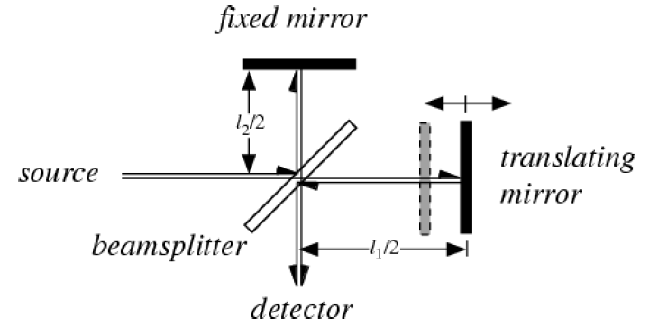
Imperial College Fourier Transform Spectrometer
IMPERIAL COLLEGE
UV FOURIER TRANSFORM SPECTROMETER
PREDISP.
DEUTER-IUM LAMP
PMT
2
LENS
EVACUATED WINDOW
To PC
IN
SO₂
OUT
ABSORPTION CELL
To PC
PMT 1
To VACUUM PUMP
1.0 - .05 cm⁻¹
Notes:
14

Slide 15
High-resolution ³⁴SO₂ spectra
0.12 cm⁻¹
1.0
~10
207.21 nm
206.87 nm

Slide 16
Integrated cross sections 0.2 torr (July 2010)
±5%
10⁻¹⁴ cm
32
33
34
36

Slide 18
Weak trend in
Δ³³S of IC cross
sections
Ueno et al. 2009
1 nm averaging

Slide 19
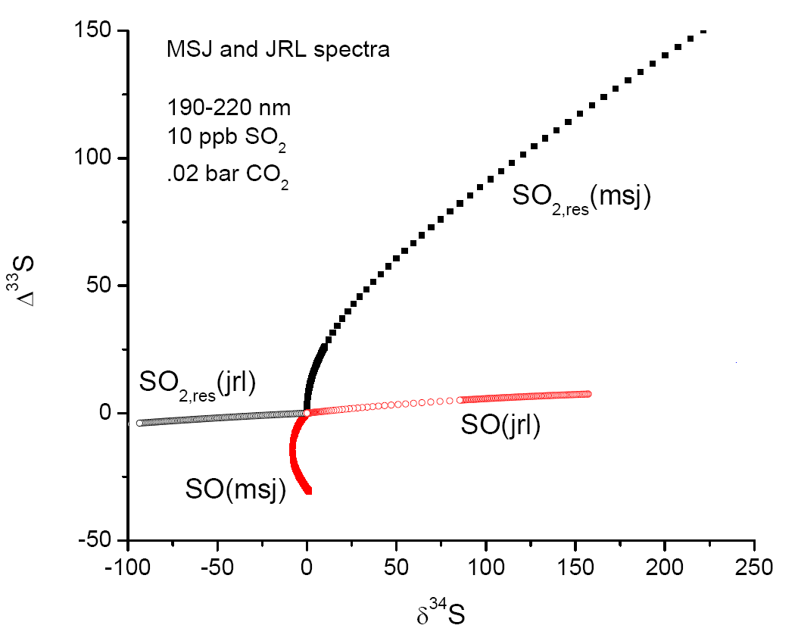
(Danielache et al. 2008)
Wing et al. (unpub)
Pen &
Clayton
(2008)

Slide 20
Up Now: Mark Claire
Up next: Itay Halevy

Slide 21
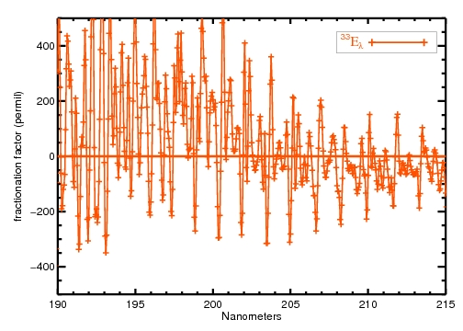
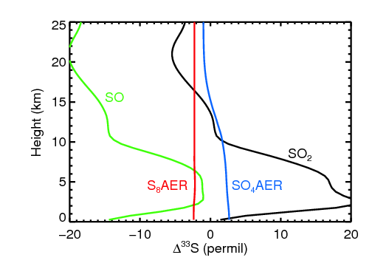
^{3x}e_{l} = 1000(^{3x}s_{l}/³²s_{l} -1)
³³E_{l} ≈ ³³e_{l} – 0.515³⁴e
SO₂ + hn ➔ SO + O
E³³_{l} in SO after photolysis (permil)
Danielache et al. JGR (2008)

Slide 22
Up Now: Itay Halevy
Up next: Hiroshi Ohmoto

Slide 23
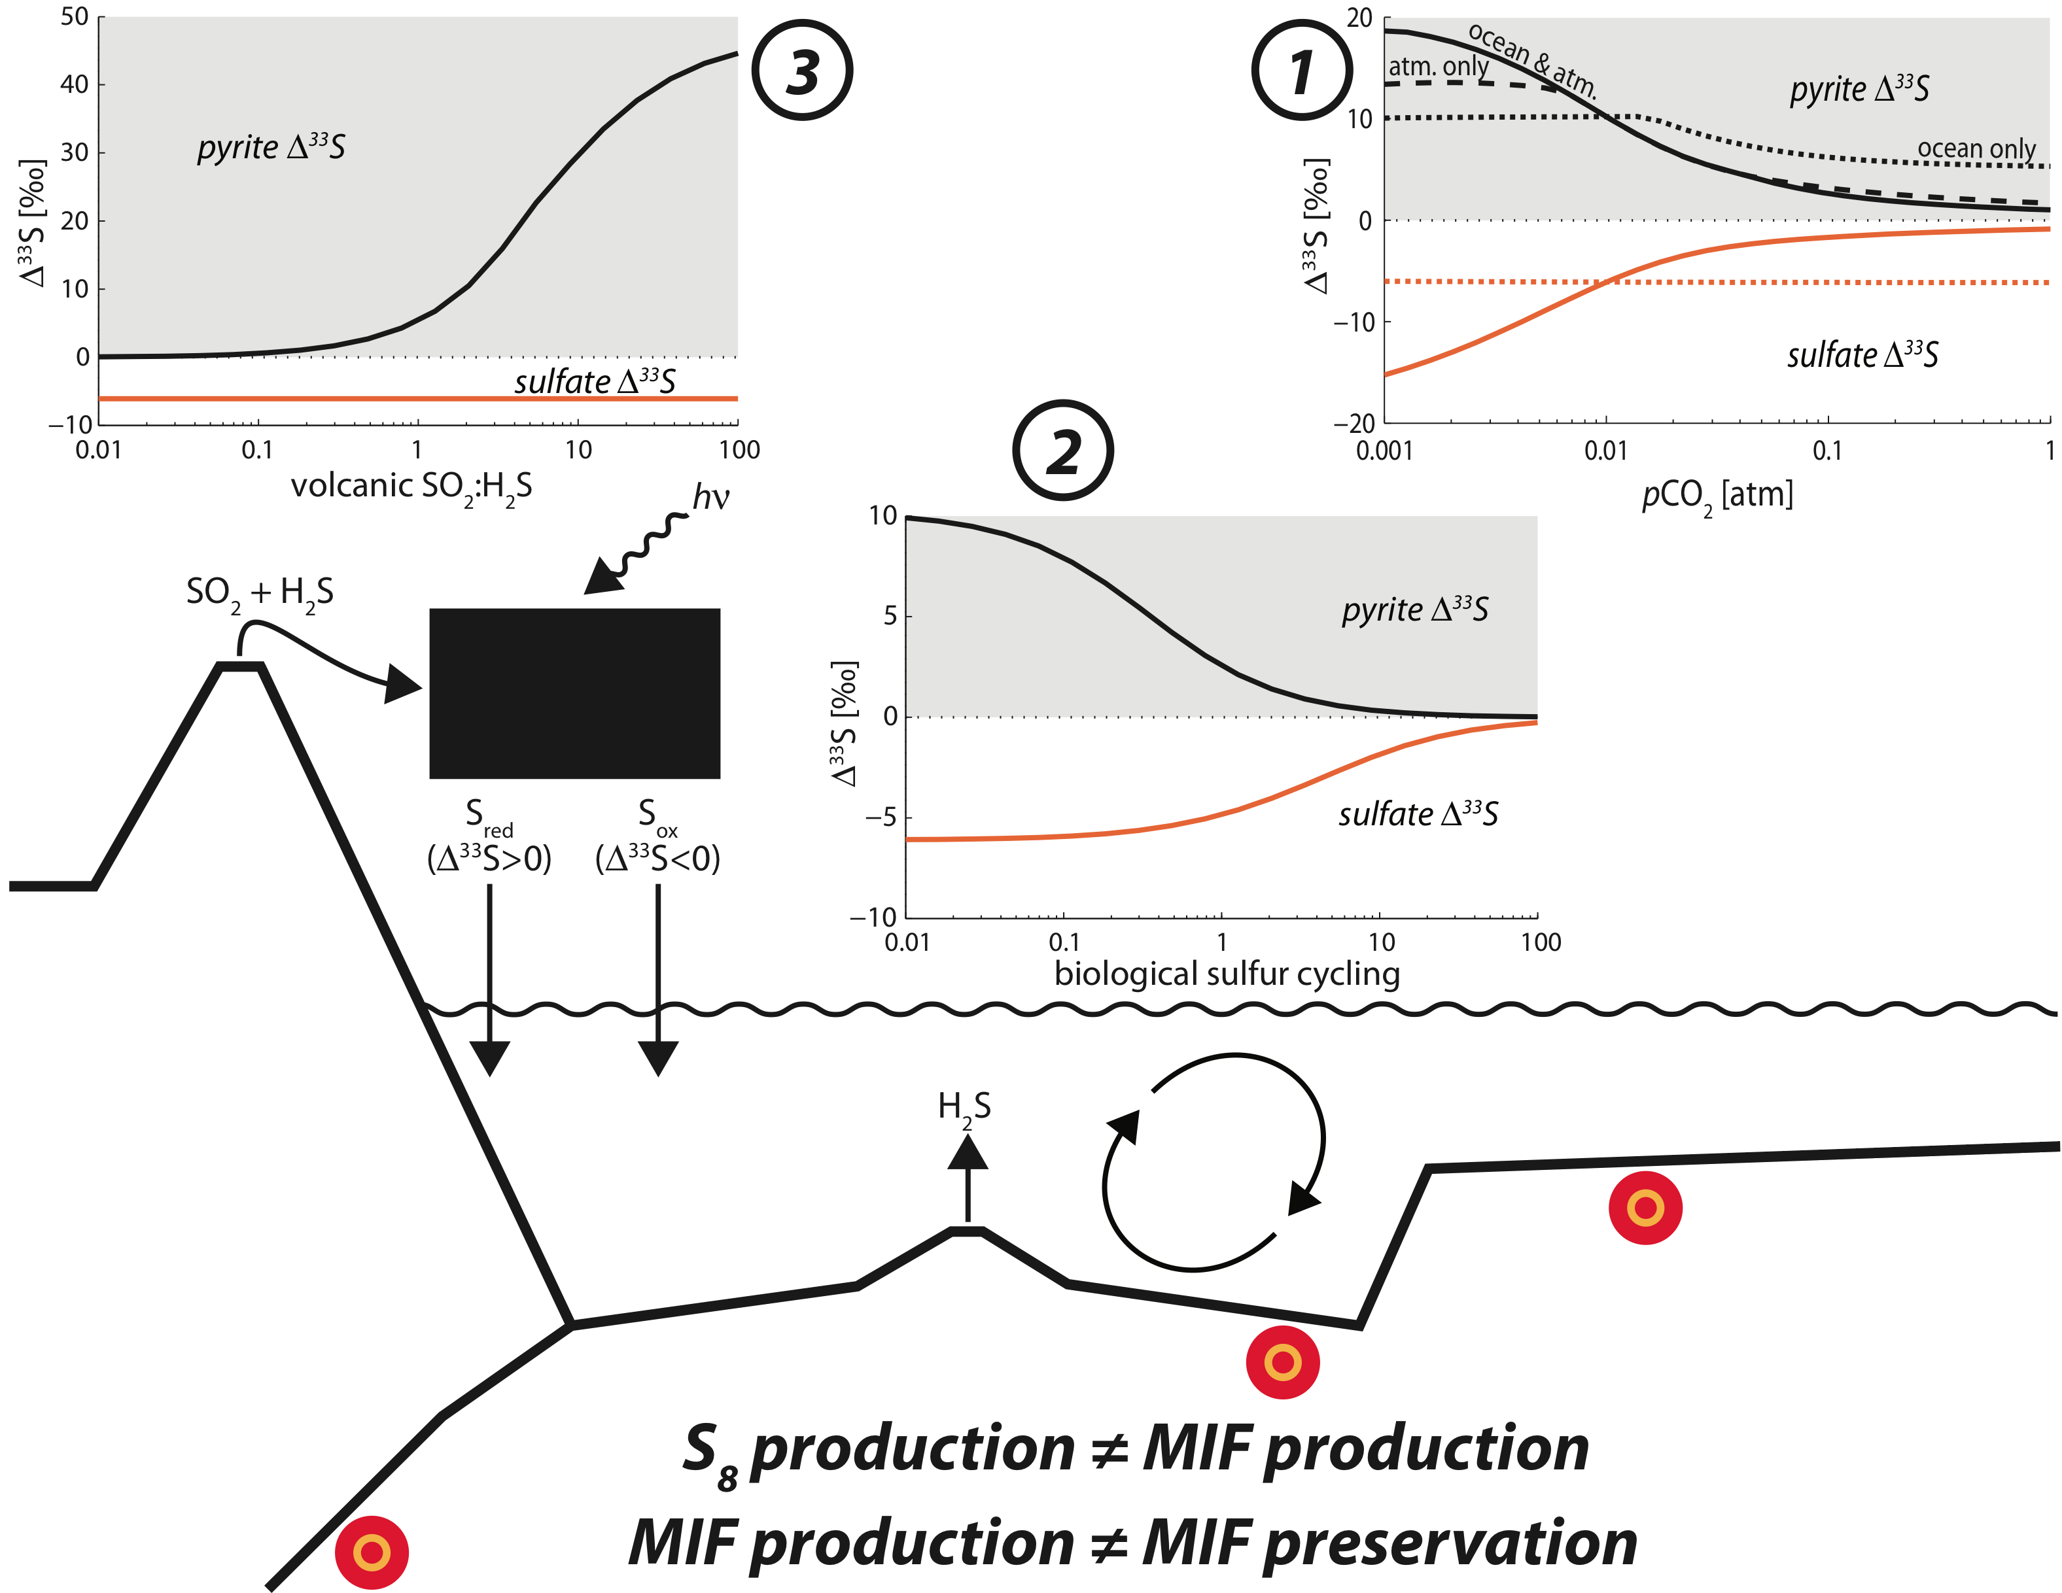

Slide 24
Up Now: Hiroshi Ohmoto
Up next: Seth Young

Slide 25
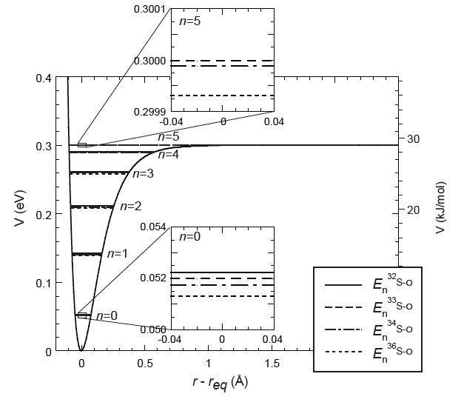
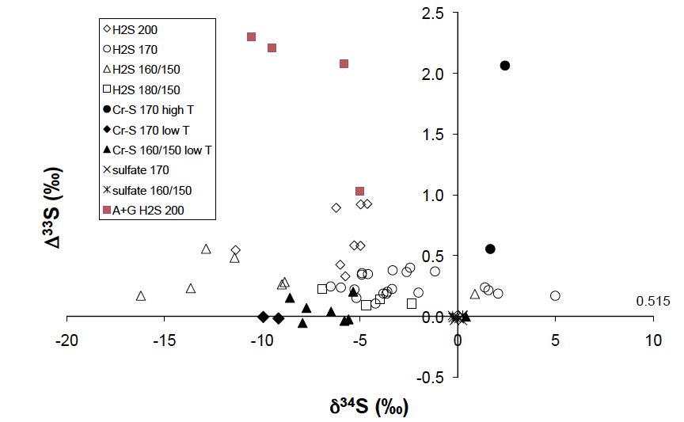
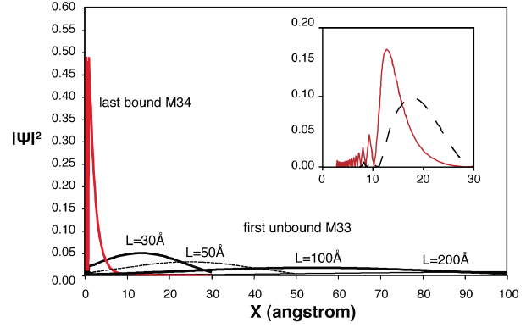
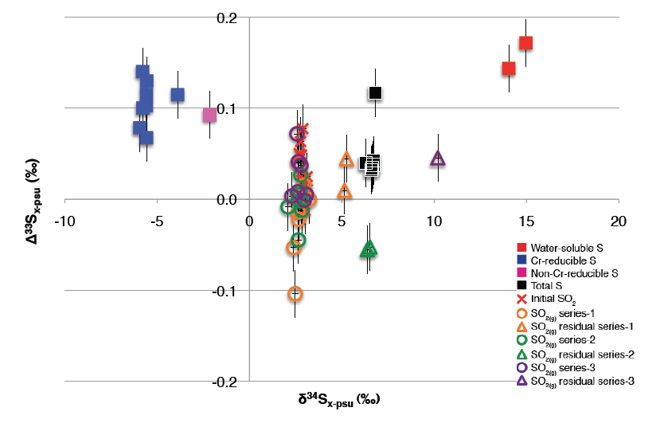
AIF-S from Chemisorption & Reduction
Hiroshi Ohmoto & Yumiko Watanabe (6/13/2011, NASA MIF-S Workshop)
AIF-S occurs when a discontinuity occurs in the number of bond energy levels for the adsorbed species of different S isotopes. (Lasaga et al., 2008)
Multiple S isotope fractionations during reactions of amino acids (xls), sulfate (xls), & H₂O at 170-200°C. Black symbols (Watanabe, Farquhar & Ohmoto, 2009); red squares (Watanabe & Ohmoto, in prep.).
reduction
adsorption
Initial SO₂
Balan et al. (2009) concluded Lasaga et al. (2008) were wrong, showing significant overlaps of the wave function distributions of bound and unbound species. But they were wrong, because their “box” was only 30Å in size; the overlaps become negligible in nature where the “box” is typically >10⁴ Å in size (Lasaga et al., in prep.)
Multiple S isotope fractionations during reactions between activated C & SO_{2(g)} at T = 200-250°C (Hamasaki, Watanabe & Ohmoto, in prep.)

Slide 26
S isotopic characteristics of adsorbates & residuals
³²S loss
³²S & ³³S losses
³²S, ³³S & ³⁴S losses
³²S & ³³S losses
³²S loss
Δ³³S

Slide 27
Up Now: Seth Young
Up next: Done!

Slide 28
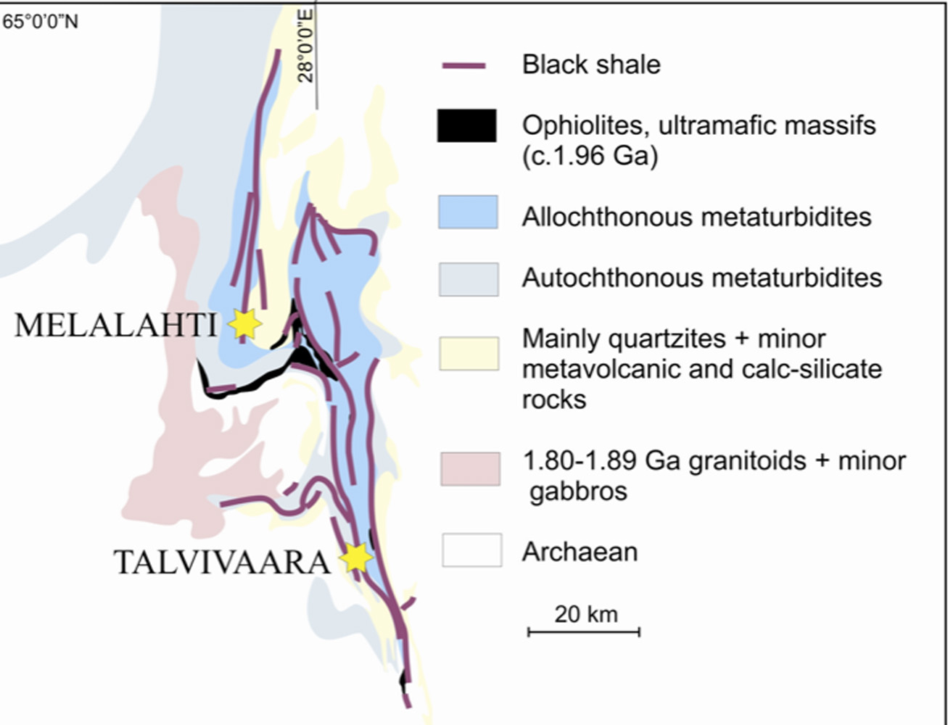
PALEOPROTEROZOIC METASEDIMENTARY ROCKS
IN EASTERN FINLAND
2.1-1.9 Ga laminated metasediments
Sulfur and Organic Carbon 7 to 10 wt.%
δ¹³C_{org} -23 to -27‰
REE patterns, Ce-depletion, DOP indicate Mn-rich anoxic seawater, near hydrothermal sites
TALVIVAARA:
Ni-Cu-Zn mine
OUTOKUMPU:
Cu-Co-Zn mine
(Claesson et al., 1993; Loukola-Ruskeeniemi & Heino, 1996;Lukkarien & Lundquist, 2000)
AVS largest Δ³³S range
Δ³³S signature similar to thermo-chemical sulfate reduction (TSR)
(Watanabe et al., 2009)
TSR consistent with sedimentary-volcanic exhalative origin for Outokumpu ore deposits
(Loukola-Ruskeeniemi, 1999)
δ³⁴S:+16.6‰ to -11.6‰
δ³³S: +8.6‰ to -6.0‰
Δ³³S: +1.25 to -0.55‰

