Slide 1
NAI Monthly Report #Team Name# - #Month reporting on#, #Year#
Progress Report
Upcoming Events
e.g.
Workshops
Team Events
Conferences
Invited Talks
Community Events
Selected Team Highlights (Conferences attended, new experiments/models, press releases, field campaigns, workshops, invited talks, etc)
Publications: accepted or published only
Efforts with Other Teams / Int’l Partners
Public Engagement
Team Member Awards
Jobs or Early Career Opportunities Offered
Issues/Concerns/Needs From NAI
And/or Moment of Science
(Budget matters should be discussed privately)
Moments of science are designed to be a snippet of research that you believe is of interest to other NAI team(s) or should be considered for Nuggets. A figure and 2-4 sentences are desired.
(A 2nd page for Moment of Science is acceptable)
**Please let us know if this data is public or should be kept internal to NASA and other NAI Teams**
Note: Please provide photos if available. (Helps with nuggets, communications to HQ, reporting, etc)

Slide 2
How will NAI use these monthly reports?
1. Monthly NAI EC reports
a. Purpose: Distributed to OCS/SMD program exec/scientists to update stakeholders on NAI activities
b. Contents: Moments of science and/or exploration, team activities/events, publication database updating, CS/PE activities, programmatic/fiscal issues
2. SMD Nuggets (SNuggets)
a. Purpose: Results of significant merit that may be passed up to the AAs/9th floor/OMB/etc.
b. Contents: Science heavy
3. NASA Ames Project Tag
a. Purpose: ~10 min presentation every other month to Ames EC to look for synergies and opportunities within Ames
b. Contents: Science and CS/PE focused results and major programmatic highlights
4. NASA Ames Highlights – NASA Administrator/Center Director ViTS
Purpose: Each center provides weekly highlights to AAs and Administrator
Contents: Science focused results and major programmatic highlights of note. SNuggets are usually reported here as well.
5. Presentations at National/International meetings
6. Web Stories / Newsletter / Social Media Promotion

Slide 3
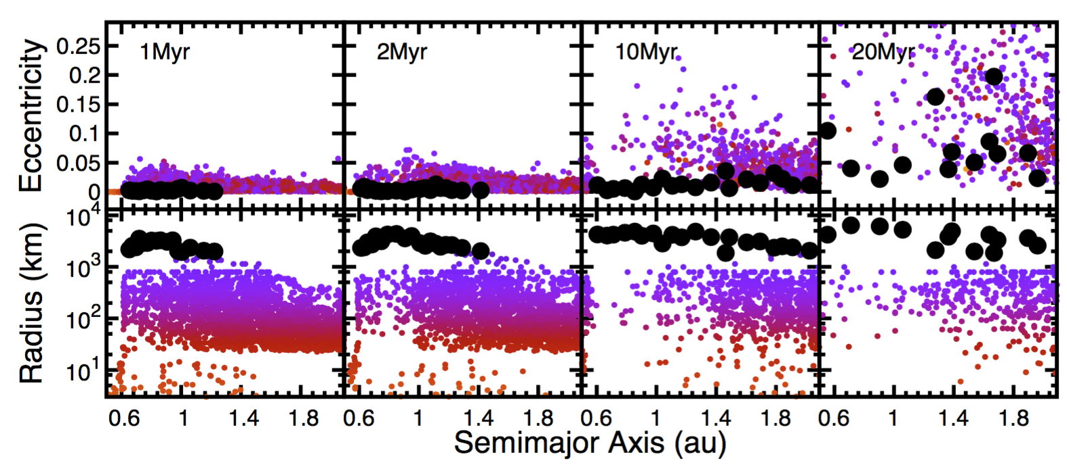
SSERVI March 2017 Progress Report Institute for the Science of Exploration Targets – PI Bottke
Progress Report
Bottke: 1) Gave invited talk at Microsymposium on major questions involving asteroids. 2) Gave talk at LPSC on evidence for 2 bombardment populations in the early Solar System. 3) Sent in proofs for Nature Geoscience paper wit Jeff Andrews-Hanna and Annual Reviews paper with Marc Norman. 4) Had discussions about chapter for New Views of the Moon II regarding lunar bombardment with Barb Cohen and Marc Norman.
Congratulations to Alex Parker and ESPRESSO for their SSERVI team win. We look forward to working with them.
Many ISET team members attended LPSC and presented SSERVI-related work
Robbins: Presented poster at LPSC “A Global Lunar Crater Database, Complete for Craters ≥1 km, II”
Marchi: 1. Working with R. Canup on SPH simulations of low mass terrestrial impactors, relevant for the late accretion. Robin gave a talk at LPSC and we are now finalizing a manuscript (in coll with R. Walker, U Maryland) 2. Working on a comparison between Ceres and lunar cratering (in coll with R. Strom, LPI). Draft manuscript is in advanced stage. 3. Received a referee report for a manuscript in coll with Craig O'Neill (Macquarie University), and we resubmitted the revised paper.
Nakajima/Canup: M. Nakajima (Carnegie Institute of Science) gave talk “Origin of the Martian Moons and Their Water Abundances“ at LPSC.
Salmon: Gave public talk “Origin of the planets and Earth’s Moon” at a Science Palooza on Sunday before LPSC.
Canup/Salmon: Continuing preparation of paper on the origin of Phobos and Deimos.
Scheeres: 1) Scheeres was elected at the National Academy of Engineering. 2) Gave talk “Constraints on the past spin rate of comet 67P/C-G” at LPSC. 3) Will give 3 presentations at upcoming ACM meeting.
Kretke: 1) Had discussions with David Kring and Bill Bottke on the origin of C-complex asteroids and carbonaceous meteorites. 2) Working on improving numerical models of planet formation.
Nesvorny: presenting work on early bombardment triggered by giant planet migration with Fernando Roig at the upcoming ACM meeting.
Upcoming events
Asteroids, Comets, Meteors, April 10-14, Montevideo (Uruguay)
Accretion, differentiation and early evolution of the terrestrial planets. May 29 –June 03, Nice, France.
The evolution of the entire inner Solar System during “classical” growth from planetesimals to planets using LIPAD simulations. The growth of planetary embryos (black circles) proceeds in a very inside-out process, where a suite of quasi-stable Mars-mass embryos are formed inside 1au in 1 Myr, and not at 2 au until nearly 20 Myr.
3/31/2017

Slide 4
SSERVI Central Mar. 2017 Report
Progress Report
Key Upcoming Events
Programmatic
Announced CAN 2 Selections,
Worked on SSERVI Budget and new Team CoOp Agreements
JSC Workshop with Space Suit & EVA Teams
Presented to AES Mid-Year Review
Reporting; ARC BPR report; Wrote and edited content for 2017 Annual Report.
Identified potential SOC members
Collected all ESF award nominations
Web/Tech
Produced the Pre-Proposal Conference “Space Radiobiology and Human Health Countermeasures Topics.”
Produced five SSERVI CLASS Tech and Future of ISRU Seminars featuring Oscar Monje, Phil Metzger, Tony Muscatello. Jason Dunn and Rob Mueller
Provided Adobe Connect training sessions for NESSF Panel Reviews
Prep support for the HRP Pre Proposal briefing; Production support and pre-production training and testing of remote presenters for the AES Mid-Year review.
Website development for awards and forum; server updates; system support and procurements; cloud infrastructure discussions
Communication Outreach
Participated in Journey Through the Universe event; produced outreach book “Yes I work for NASA. No I’m not an astronaut;”
Logo design for Small Sat Virtual Inst.;
sourcing and production for Lunar Eclipse glasses;
Initial design layout and illustration for ELS, Toulouse.
Created web graphics and posted articles to SSERVI website—team relevance includes: “ExMASS” (Kring; CLSE); Sudbury Field Camp (CLRN/CLSE); Vision 2050 (Kring/CLSE); “Earth’s First Stable Continents” (Bland/AUS);
ARC Podcast (Pendleton/all teams);
Posted social media highlights.
Glotch Team Site Visit Apr. 27-28
ELS 2017, Muenster, May 2-3
New Views of the Moon II, Muenster, May 4-5
CAN-2 Teams Start, June 1
ESF, NASA ARC, July 18-20
Autonomous Missions for SMD Workshop, NASA ARC, July 21
Funding Status
Reminder: CR through 4/28 after which either a full year CR or budget will be passed at that time.
Still awaiting authorization for some of FY17 AES coverage funds.
If your team is in immediate need of funds, please let us know so we can prioritize your team.
For CS teams and CO-Is, The next installment will be sent after 4/28.

