Slide 1
Interdisciplinary collaboration on O-MIF
Gerardo Dominguez
Mark Thiemens
University of California, San Diego
Department of Chemistry and Biochemistry
Notes:
Good morning. I would first like to thank the organizers of this committee for the opportunity to give this talk today.
As many if not all of you know, oxygen plays key roles as both a rock forming and at the same time volatile element in nature. The fact that it has three stable isotopes

Slide 2
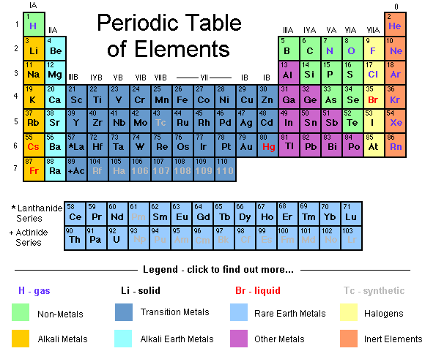
Why Oxygen?
Notes:
Like sulfur, oxygen occupies a very special place in the periodic table. It has three stable elements, and is found in both rock forming and volatile species.

Slide 3
Foundations
Foundations in Equilibrium Thermodynamics
Partition Functions depend on
mass or reduced mass
Leads to “Mass-Dependent”
Fractionation Patterns
Quantum Mechanics as a Basis for
Isotopic Fractionation
Mass spectrometry has been method of choice
Notes:
While many if not all here are familiar with these papers, it is important to remember that the foundations by which we interpret variations in the isotopic composition of natural compounds assumes thermodynamic equilibrium. The mass dependence of equilibrium fractionation is found in the mass dependence of the partition functions of compounds.

Slide 4
Mass Dependent Processes Define Slope ½ Line
δ¹⁷O
Terrestrial Silicates
TFL
SMOW
20
10
O₂ (atmos.)
-40
-20
20
40
δ¹⁸O
-10
Terrestrial Rainwater
-20
Notes:
And, as a result of equilibrium thermodynamics being a predominant process for most terrestrial oxygen systems, we have the well known slope ½ line known as the terrestrial fractionation line.

Slide 5
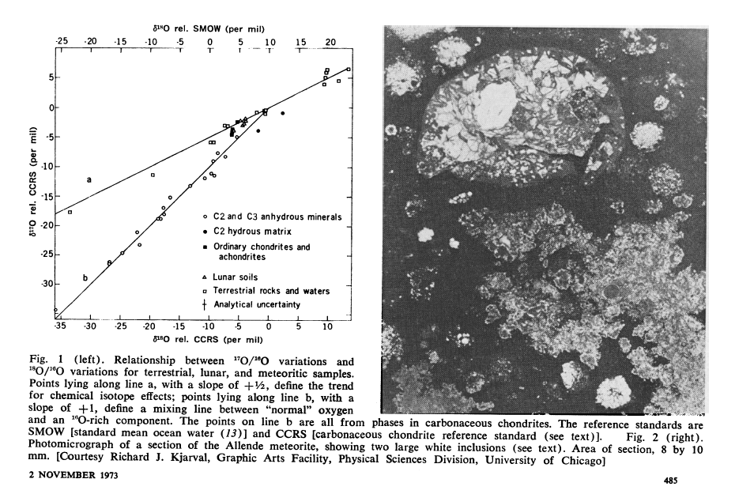
Clayton
Discovery of a process where δ¹⁷O ~ δ¹⁸O !
R.N. Clayton, L. Grossman, and T.K. Mayeda, Science, 1972
Notes:
In 1972, Clayton and coworkers discovered that high-temperature inclusions found in the newly fallen Allende meteorite were fractionated along a line that deviated from the TFL.
Because, at the time, it was believed that only nuclear processes could lead to deviations from the canonical mass-dependent fractionation line, it was proposed by the authors that a pure 16O injection from a nearby SN was responsible for this remarkable pattern.
In hindsight, we know better, since we know that ozone production, as we saw in the last couple of talks, is mass independently fractionated. But, we wouldn’t be here if today if that assumption was not challenged.

Slide 6
Motivation for O₃ experiments (<1983):
Big assumption in the field was that only nuclear processes (spallation, radioactive decay, injection of SN material) could lead to deviations from mass-dependent fractionation
Chemically, however, identical particles (¹⁶O ¹⁶O) are indistinguishable
→leads to differentiation in the number of quantum states for symmetric and asymmetric O₃ molecules
Notes:
As stated, it was a big assumption that only nuclear processes could produce MIF.
However, from a physical chemical point of view, there were qualitative reasons based on the physical insight that, to expect there to be differences in the quantum levels of between symetric and asymmetric molecules. Ozone, being made up of oxygen and a linear molecule, might be a good test of the nuclear assumption.

Slide 7
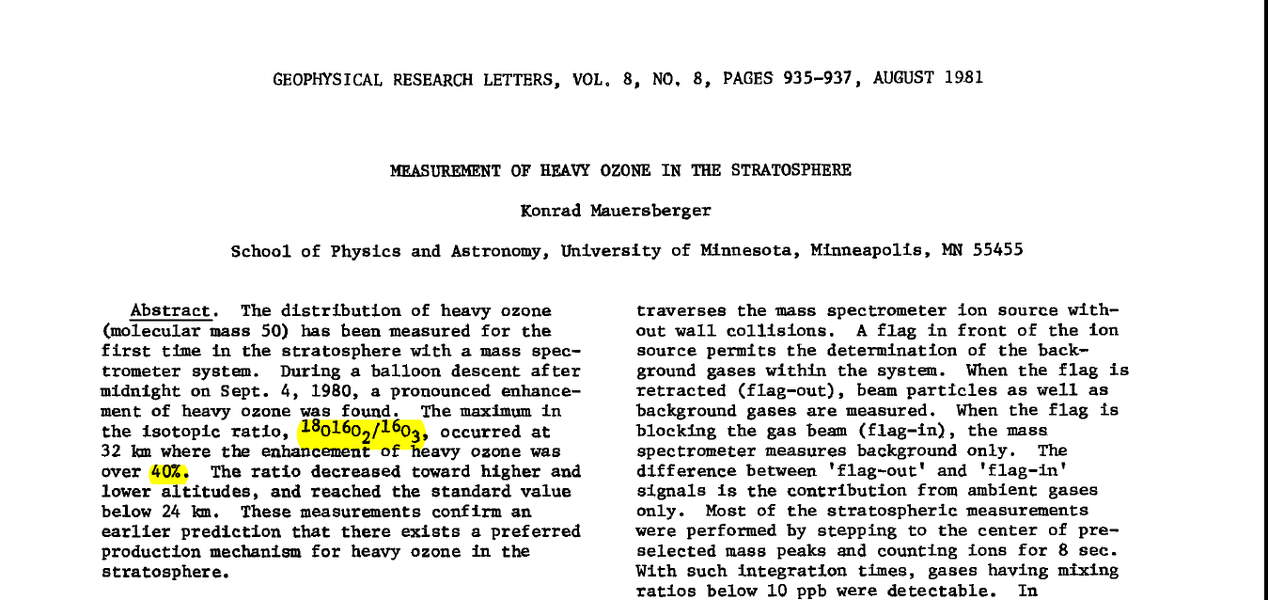
Heavy Ozone= MIF ?
Note, no ¹⁷O measured
& 400 per mil effect for δ¹⁸O?!
Notes:
As a side note, there appears to be a widespread misperception that measurements of Mauersberger in 1981 motivated later work on MIF of oxygen isotopes. Two points: 1) no 17O was measured in this study and 2) the author reported a 400 per mil effect for d18O, which is now known to be incorrect. So the paper is basically wrong and has no relevance to discussions of MIF

Slide 8
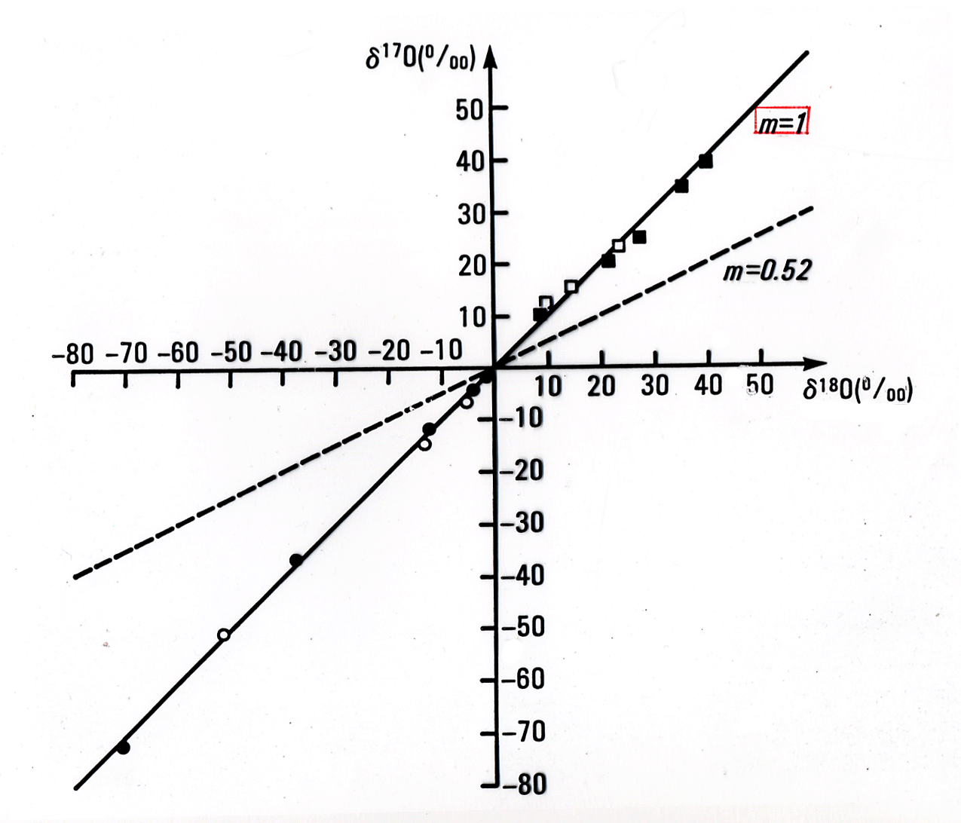

Ozone (O₃) formation in gas-phase is Mass-Independently Fractionated
A Chemical Process May Produce Anomalous Fractionations
Thiemens and Heidenreich, Science , 1983
Notes:
This paper, is however very relevant as all three isotopes of oxygen are measured in the chemical production of ozone in the laboratory. This process involving atomic oxygen and molecular oxygen is by its nature a kinetic process.
What ever the process, it deviates from assumptions of thermodynamic equilibrium
Having shown that nuclear processes are not necessary, Thiemens and Heidenreich had the privilege of speculating about the reason for this discovery as well as its implications for the solar system.

Slide 9
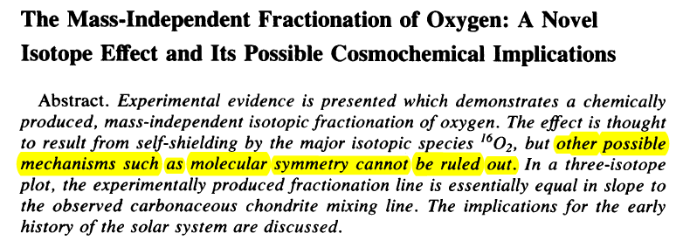
Proposed Models for MIF Effect of O₃ and Early Solar System (1983)
Molecular Symmetry ?
Notes:
slide 9. can you also highlight self shielding. it is first predicition that CO self shielding in nebula accounts for meteorites

Slide 10
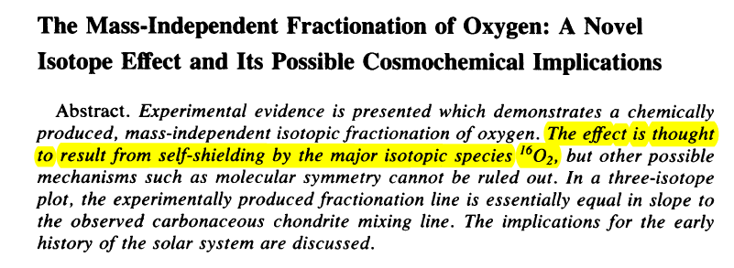
Proposed Models for MIF Effect of O₃ and Early Solar System (1983)
Self Shielding of O₂ ?

Slide 11
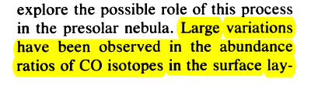
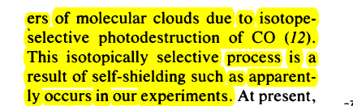
Proposed Models for MIF Effect of O₃ and Early Solar System (1983)
Self Shielding of CO
Notes:
So, even though the explanation for the isotope effect in Ozone production, the self-shielding of O2 turned out to be incorrect, letting go of the constraint that only nuclear processes can produce MIF allowed the authors to imagine other scenarios where this self-shielding effect might be relevant. Thus, it seems that Thiemens and Heidenreich may be proponents of self-shielding. We’ll come back to this issue of self-shielding later in this talk

Slide 12
First explanation summary
Isotopic self shielding of O₂ to explain lab experiments
Suggestion that effect may be relevant for solar system (CO self-shielding)
O₂ as a producer of MIF in solar nebula kinetically ruled out by Navon and Wasserburg (1985)

Slide 13
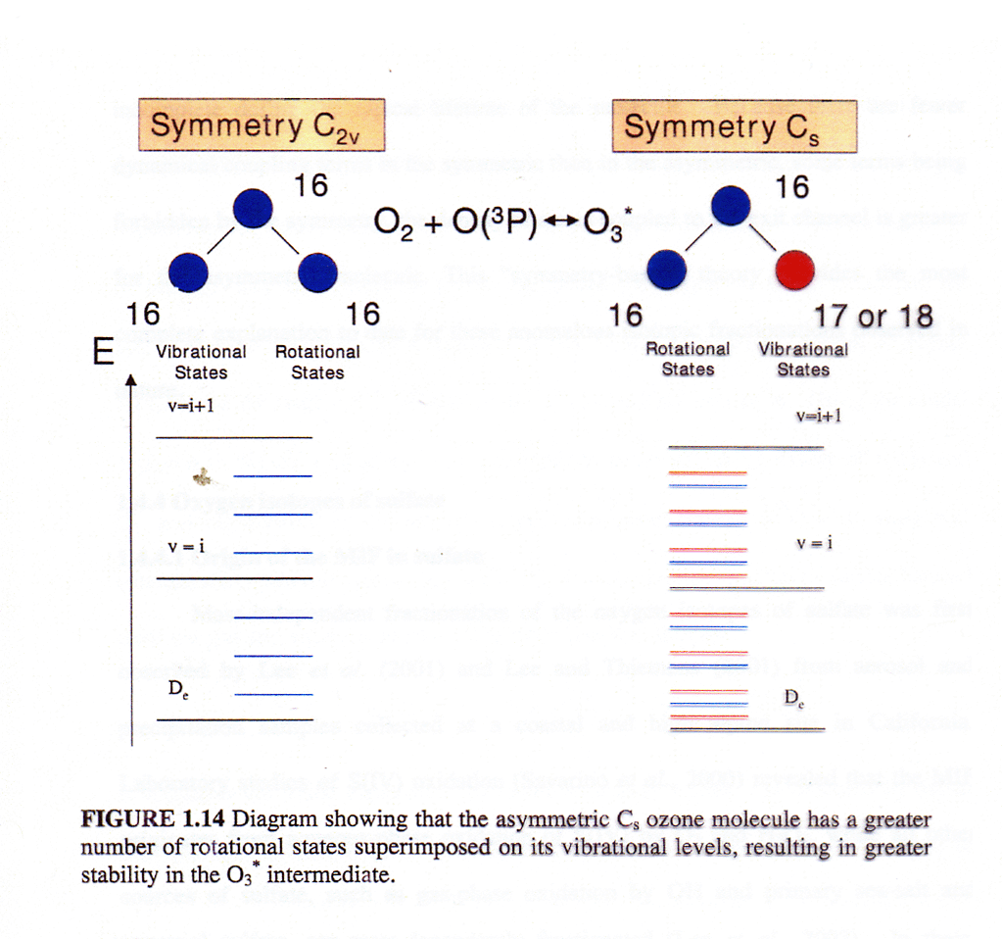
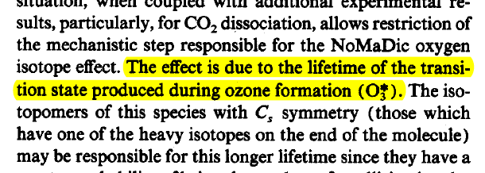
Thiemens and Heidenreich (1986)
Notes:
Subsequent work by Thiemens and Heidenreich concluded that the symmetry of the transition state associated with O3 formation is responsible for the mass-independent fractionation associated with ozone formation as shown here

Slide 14
Non-RRKM theory
Enrichment depends on the symmetry of the intermediate complex formed during collision.
N⁺_{EJ} is the number of quantum states accessible to the transition state for dissociation from a given E and J state
ρ_{EJ} is the density (number per unit energy) of quantum states of the vibrationally excited molecule
The shaded region for the asymmetric molecule constitutes a greater fraction of the total region
Gao and Marcus, Science (2001)
Notes:
This qualitative explanation was put into quantitative terms by Gao and Marcus in 2001 who found differences in the lifetimes of symmetric and asymmetric ozone transition states.

Slide 15
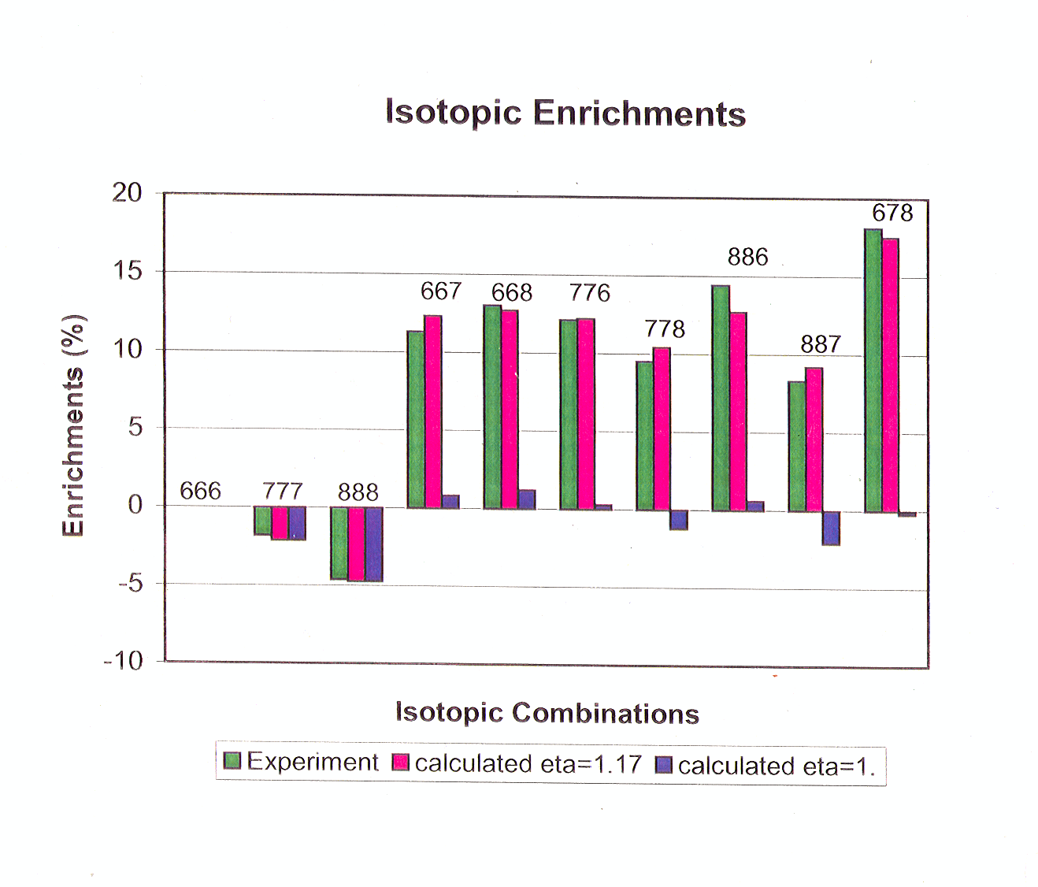
Notes:
One crucial ingredient that was invoked by Gao and Marcus is the concept of a non-RRKM factor, an eta factor, that quantified departures from a statistical occupation of energy levels in the O3* transition state

Slide 16
Geochemical Applications

Slide 17
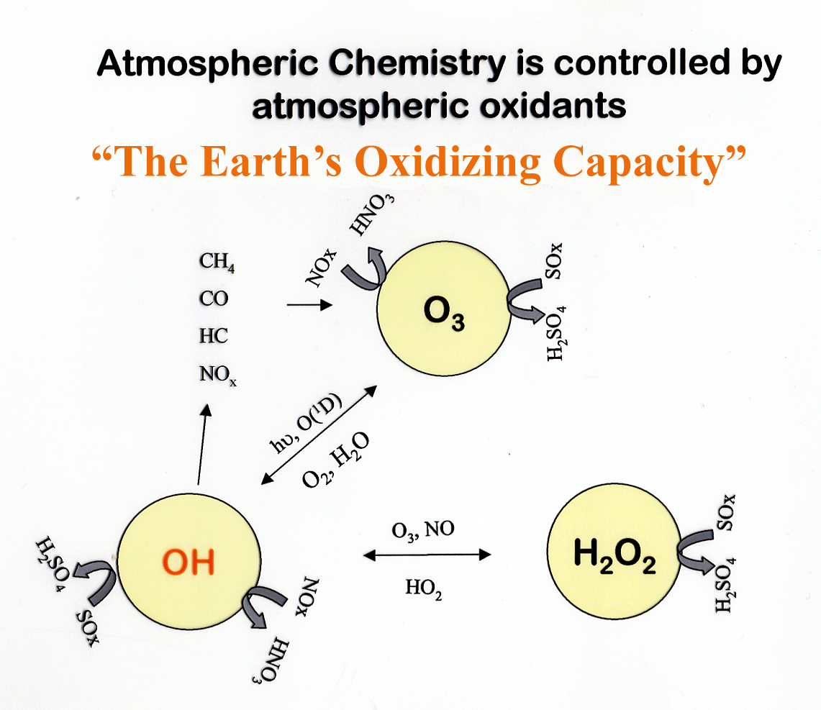
Notes:
Earth’s atmosphere an of a geochemical system that does not reach thermodynamic equilibrium, due in large part because of the presence of photons which facilitates the formation of ozone and radical species like OH.

Slide 18
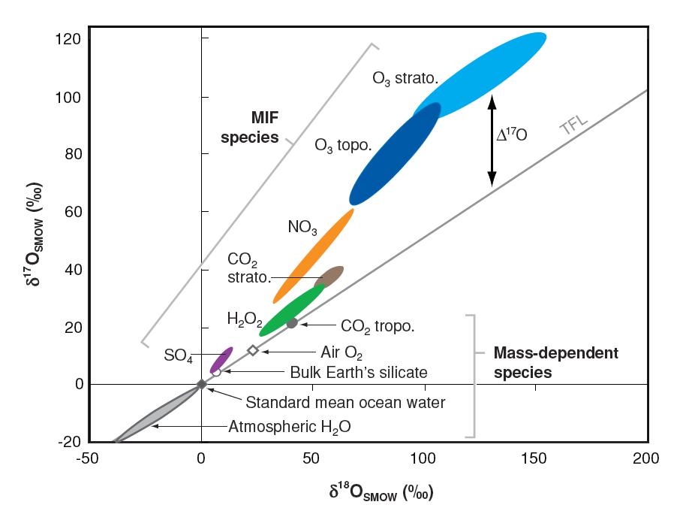

MIF in Ozone Important for Other Atmospheric Species
atmosphere
M. Thiemens, Ann. Rev, 2006
Notes:
This plot summarizes triple-oxygen isotopic measurements of various compounds in the atmosphere. To first order, the location of these compounds is given by the relative importance of water or OH oxidation played vs. ozone oxidation.

Slide 19
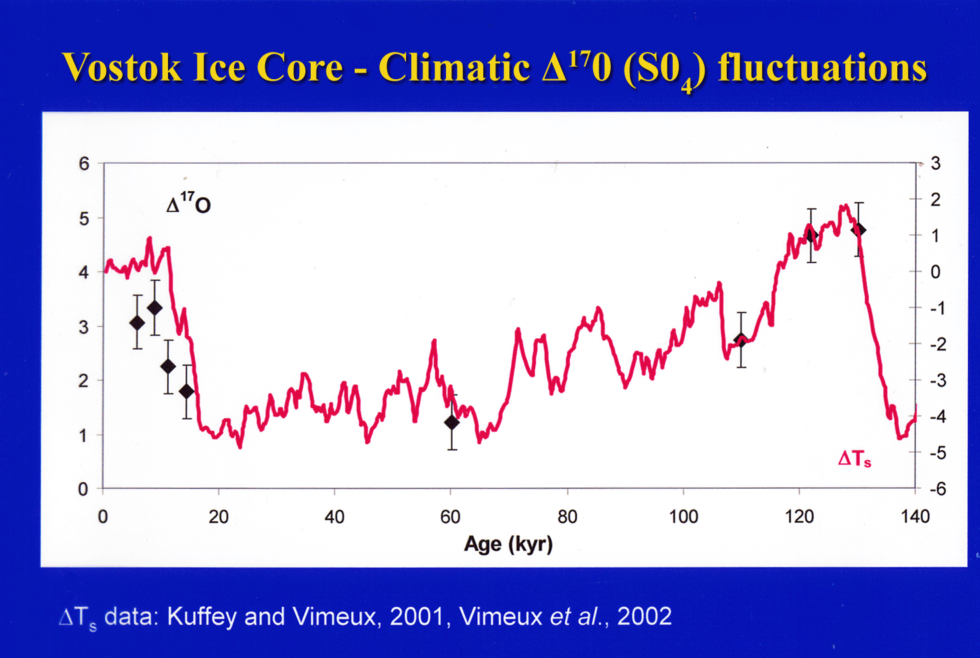
Notes:
Measurements of ice core sulfate therefore allow one to reconstruct the oxidative conditions of the atmosphere in the past. This plot suggests that during colder climates, there is less water in the atmosphere and therefore less ozone oxidation since ozone oxidation requires aqueous aerosol surfaces.
temp trrend it is NOT temp per se;it is the amount of water. high temps--> more water--> greater ozone an anomlay
low temps--->less water, OHit is a real advantage of the mass independent

Slide 20
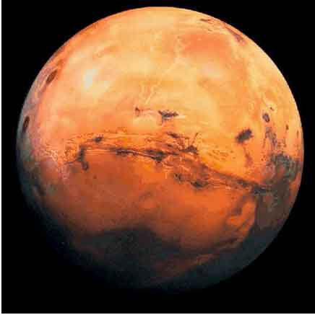
Notes:
Is there water on Mars? How much of it is there? In my opinion this photo settles the issue

Slide 21
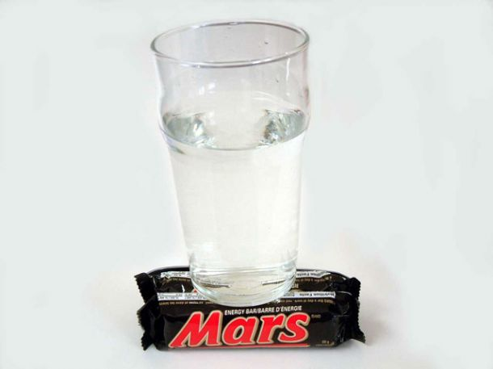

Slide 22
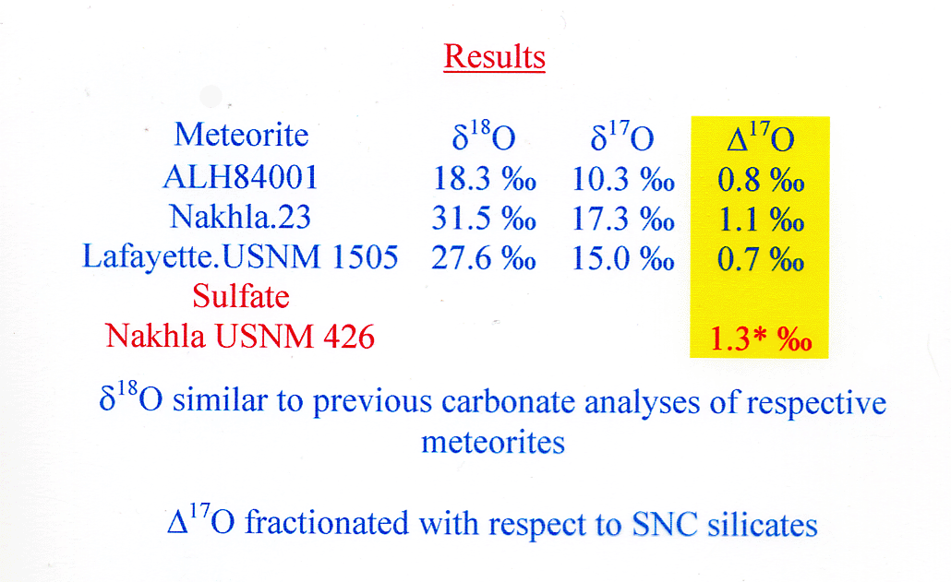
Oxygen in Martian CO₃
Farquhar et al., Science, 1998
Notes:
Disequilibrium

Slide 23
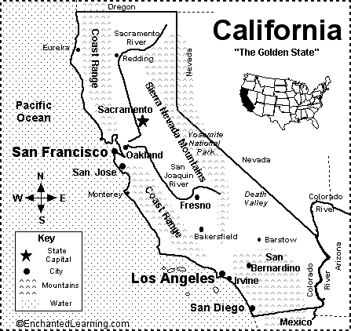

Detection of oxygen isotopic anomaly in terrestrial atmospheric carbonates and its implications to Mars
R. Shaheen, A. Abramian, J. Horn, G. Dominguez, R. Sullivan, and Mark Thiemens,
Proceedings of the National Academy of Sciences, 2010

Slide 24
Oxygen Isotope Anomaly in atmospheric CO₃
Δ¹⁷O
Δ¹⁷O
Oxygen isotope anomaly in terrestrial aerosol carbonate

Slide 25
Mechanisms of Oxygen Isotope Exchange
A= existing carbonates
B= in-situ carbonate formation
(A)
(B)
O₂
O₃
CO₂
CO₂
O
O₃
O₃
O₃
:
O
O
:
γ⁻
O
O
γ⁺
γ⁻
γ⁺
-
-2
H
CO₂
HCO₃
CO₃
MCO₃
H
H
H
-
-
H₂O
O
O
OH
OH
O
O
M
C
M
C
MO+ H₂O
-
M(OH)+ OH
O
O
Fig. . The molecular mechanism of the origin of Oxygen Isotope Anomaly in Atmospheric Carbonates . A). Ozone isotope exchange on existing carbonate aerosols with dissociative adsorption of water. B). In-situ formation of carbonates and interaction with ozone on particle surfaces.
Notes:
Detailed laboratory experiments confirmed that liquid water is a necessary condition for the formation of isotopically anomalous carbonate. Furthermore, these experiments showed a direct link between ozone decomposition on the surface of water and anomalous hydrogen peroxide. This is very exciting work as it shows the power of using multi-oxygen isotopes to understand both the terrestrial and martian atmospheres.

Slide 26
MIF in CO₃ Summary
Anomalous CO₃ discovered in Earth’s Atmosphere on aerosol particles
Controlled laboratory studies show that anomaly transfer from O₃ to CO₃ requires SOME liquid water
Helps to explain disequilibrium chemistry of Martian CO₃
Highlights the importance of heterogeneous chemistry on surfaces and power of MIF signal in understanding these reactions

Slide 27
The Solar System Revisited

Slide 28
The Distribution of Oxygen Isotopes in the Solar System
δ¹⁷O
Asteroidal H₂O
SMOW (Earth)
20
TFL
Mars
10
Terrestrial Rocks
-100
-80
-60
-40
-20
Terrestrial Rainwater
20
40
δ¹⁸O
-10
Chondrules
-20
The Sun ?
-30
?
Calcium-Aluminum Inclusions (4.56 Gyrs.)
Solar Wind
(-99, -79)
(-60,-60), Δ¹⁷O~ -26.5± 5.6 ‰
Notes:
Here again is the distribution of oxygen isotopes in the solar system. This distribution is clearly mass independent with the terrestrial planets being enriched in both 17O and 18O compared to the CAI

Slide 29
Photo-chemical origin: Self-shielding of CO
Self-shielded zone
[^{17,18}O]/[¹⁶O]
hν
CO (C¹⁶O + C¹⁸O + C¹⁷O)
91 – 111 nm
¹²C¹⁷O
¹²C¹⁸O
¹²C¹⁶O
Immediate consequence of self-shielding: δ¹⁷O/δ¹⁸O = 1 fractionation line
Notes:
If we try to visualize the same with CO molecule, instead of O₂, we will see that preferentially ¹⁸O and ¹⁷O containing CO are breaking down after certain length.
The immediate consequence of this is…. generation of slope one line in the atomic oxygen reservoir. Self-shielding of CO has the potential to generate MIF in oxygen reservoir.
It have been observed in molecular cloud that ¹³CO/¹²CO depletes at the edge of the cloud. And similar for oxygen.

Slide 30
Self-shielding of CO in solar nebula
High above the mid plane at large R (~ 30 AU) temperature of ~ 50 K (Lyons and Young, Nature 2005)
1-D time dependent photochemical Model (with 96 species and 375 reactions)
Solved:
1-D Continuity equation for each species as a function of height at midplane
Showed:
Substantial MIF in bulk oxygen isotopes in the nebula was possible on time scales of 10⁵ year

Slide 31
Laboratory
Tests
2500
107 nm
Product CO
2
105 nm
97 nm
No need to invoke self-shielding
Fractionation in CO photodissociation is sufficient
2000
94 nm
107.61and 105.17 nm
combined
O/1000) (‰)
Slope = 1.38
1500
17
δ
1000
1000*ln(1+
97.03 nm
500
94.12 nm
Slope = 0.52
0
0
500
1000
1500
2000
2500
Chakraborty et al., Science, 2008
1000*ln(1+
δ
18
O/1000) (‰)

Slide 32
Potential Energy Diagram of CO
E¹π state is resonantly perturbed by another bound state k³π, which predissociates
➔Accidental predissociation
Klopotek and Vidal, 1985
Chakraborty et al., Science, 2008

Slide 33
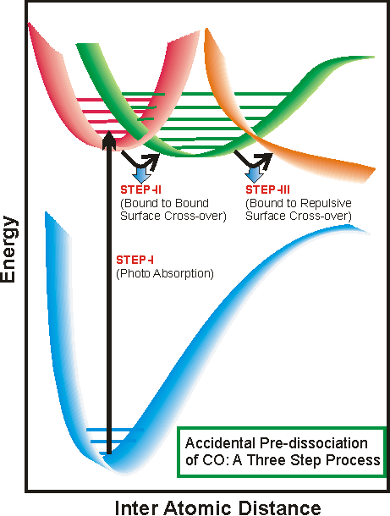
CO Photodissociation: Interpretation of the Same Slope
Simplified Picture
Accidental pre-dissociation may be the cause behind the anomalous ¹⁷O enrichment

Slide 34
Mixing Line
Slope =1.72
Experimental Mixing Line (Photochemical)
CAI Line (Slope ~1)
Sun

Slide 35
Calculations associated with an isotope effect in photoabsorption from first principles of Quantum chemistry
B.B. Muskatel, F. Remacle , R.D. Levine (Fritz Haber Institute, The Hebrew University
Jerusalem, Israel
M.Thiemens UCSD
Proceedings of the National Academy of Sciences, 2011

Slide 36
The Calculation
Use N₂: isoelectronic with CO and all potential energy surfaces known in high detail
Include all surfaces: Rydberg and valence states
White light pulse for time evolutionary Schroedinger equation and therefore isotopes
Both adiabatic and diabatic approach; significant at curve crossings and perturbational quantification
Calculate effective coupling energy and isotope effect from that

Slide 37
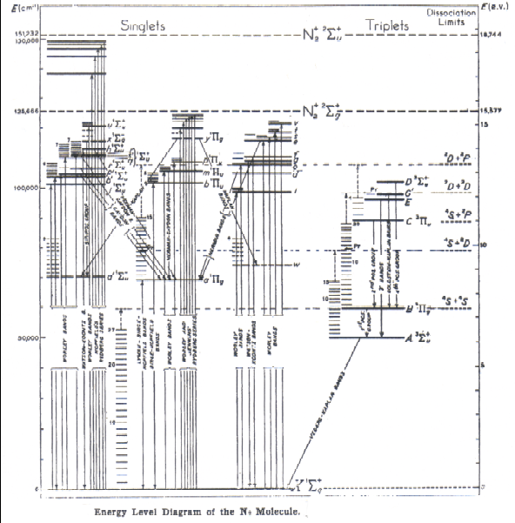
Energy Level Diagram of N₂
Σ
Π

Slide 38

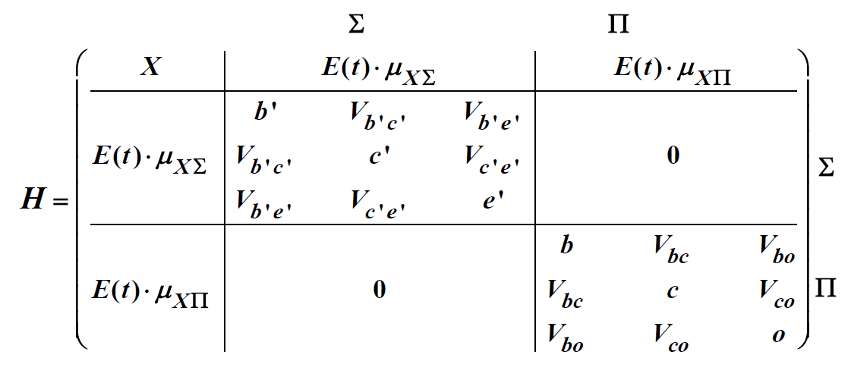
The effective coupling between the diabatic states is defined by:
Hamiltonian used in this treatment is a matrix:

Slide 39
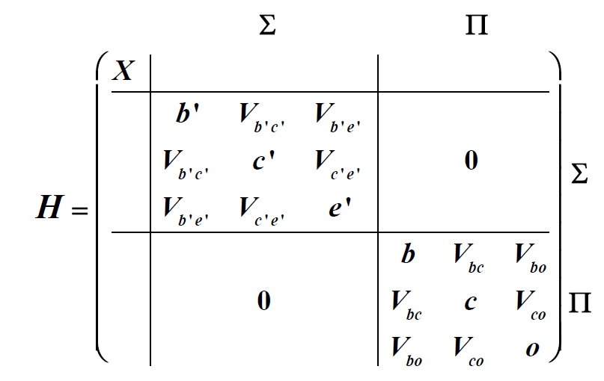
The vibrational states in the adiabatic picture are determined by
diagonalizing the Hamiltonian in the absence of the light field.
Explicitly, we diagonalize the Hamiltonian given by:

Slide 42
This is only for isotopic population from the application of white light
BUT in nature it is a solar spectrum

Slide 44
Recent Work on Oxygen in the Solar System
How?
G. Dominguez, A Heterogeneous Chemical Origin for the ¹⁶O-rich and ¹⁶O-poor
Reservoirs of the Early Solar System, The Astrophysical Journal Letters, 2010

Slide 45
The Distribution of Oxygen Isotopes in the Solar System
δ¹⁷O
Asteroidal H₂O
SMOW (Earth)
20
TFL
Mars
10
Terrestrial Rocks
-100
-80
-60
-40
-20
Terrestrial Rainwater
20
40
δ¹⁸O
-10
Chondrules
-20
The Sun ?
-30
?
Calcium-Aluminum Inclusions (4.56 Gyrs.)
Solar Wind
(-99, -79)
(-60,-60), Δ¹⁷O~ -26.5± 5.6 ‰
Notes:
This distribution of oxygen is anomalous, sometime referred to as mass-independent distribution.
99% of oxygen in the solar system is in the Sun, the rest is in the form of rocky planets

Slide 46
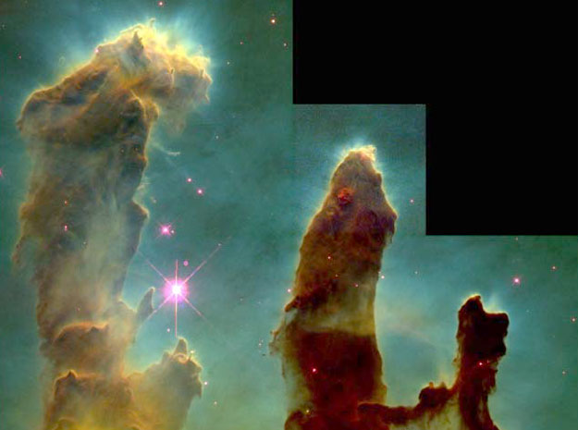
Molecular Clouds
Gas and Dust
Molecular Cloud Chemistry: H₂ and ice formation on dust grain surfaces
Gravitational Instabilities & Dust Cooling ➔ Star Formation
Eagle Nebula (Hubble Image)

Slide 47
Oxygen in Dense Molecular Clouds (n_{H}>10⁴ cm⁻³)
Dust Grains catalyze the formation of H₂, H₂O, …
Oxygen bound to interstellar silicates (~30%)
Simulations of Chemical Evolution indicate that H₂O (ice) is a major O reservoir (~50-60% of “volatile”oxygen )
How?

Slide 48
Dust Grain Surfaces Catalyze Chemical Reactions
AB
Evaporation
B
A
Diffusion
Δt
Dust Grain Surface
(T~10-20 K)
Notes:
Light species such as H, evaporate
Heavier molecules have a much longer evaporation timescale
H2 formation in the gas phase is too slow. Similarly, gas phase reactions are too slow to account for the abundances of other molecular species, including water

Slide 49
H₂O Formation in Dense Molecular Clouds (T~10 K)
Two surface reaction networks are believed to be responsible for the formation H₂O :
  O+O→O₂
  H+O₂→HO₂
  HO₂+H→H₂O₂
  H₂O₂+H→H₂O+OH
Tielens and Hagens, A&A, 1982
Cuppen Herbst, ApJ, 2007
Ruffle & Herbst, MNRAS, 2000
# 1
E_{A} = 1200 K ?
E_{A}= 0 K (Ioppolo et al., 2008)

Slide 50
H₂O Formation in Dense Molecular Clouds (T~10 K)
  O₂+O →O₃
  H+O₃ →OH+O₂
  H+OH→H₂O or H₂+OH→H₂O+H
Tielens and Hagens, A&A, 1982
Cuppen Herbst, ApJ, 2007
Ruffle & Herbst, MNRAS, 2000
# 2
E_{A}= 0 K
Most favored pathway involves O₃ !

Slide 51




Isotopic Evolution of Cloud
  O₂+O→O₃
  H+O₃→OH+O₂
  H+OH→H₂O or H₂+OH→H₂O+H

Slide 52
The Distribution of Oxygen Isotopes in the Solar System
δ¹⁷O
Asteroidal H₂O
SMOW (Earth)
20
TFL
Mars
10
Terrestrial Rocks
-100
-80
-60
-40
-20
Terrestrial Rainwater
20
40
δ¹⁸O
-10
-20
Chondrules
The Sun ?
-30
Δ¹⁷O(H₂O-nebula) =Δ¹⁷O(Sun)+ ψ
?
Calcium-Aluminum Inclusions
(4.56 Gyrs.)
if Ψ = 25-35 ‰
Solar Wind ?
(-99, -79)
(-60,-60), Δ¹⁷O~ -26.5± 5.6 ‰
Notes:
This distribution of oxygen is anomalous, sometime referred to as mass-independent distribution.
99% of oxygen in the solar system is in the Sun, the rest is in the form of rocky planets

Slide 53
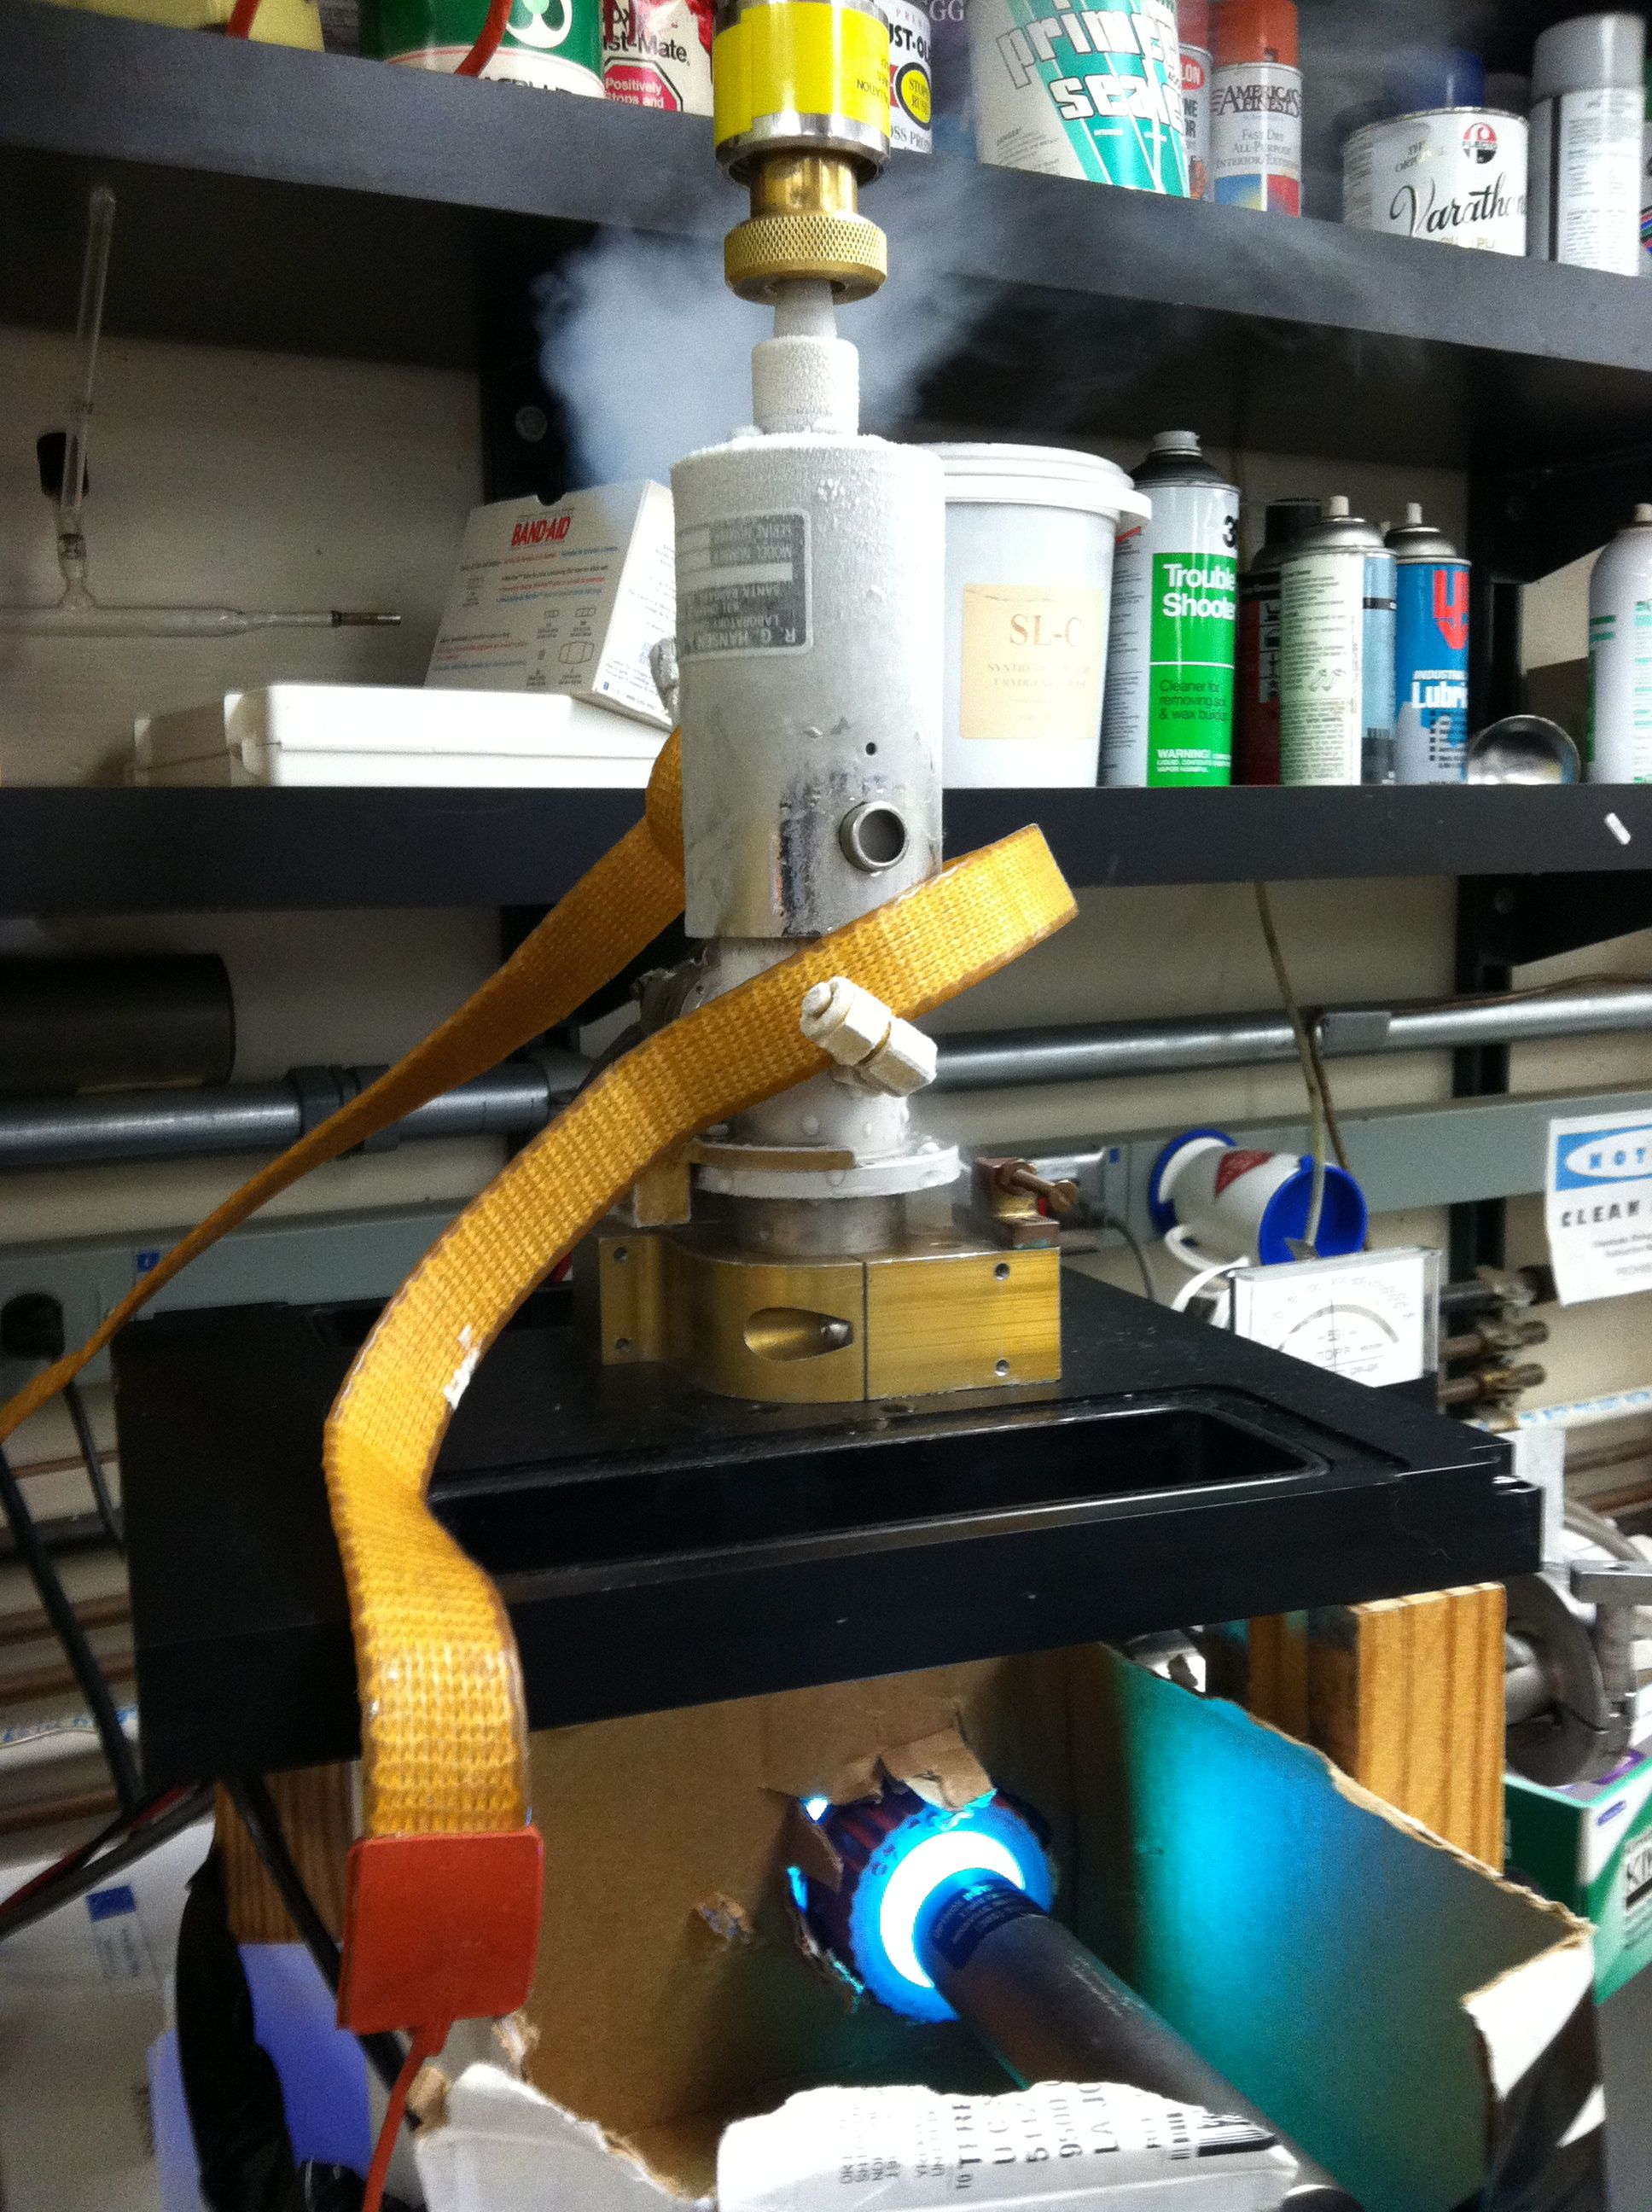
Current and Future Work
Ozone formation on surfaces at 10-30 K and multi-oxygen isotopic measurements
Our understanding of isotopic fractionation and surface chemistry in interstellar conditions (T~10 K) is very limited and is an exciting area of current and future research

Slide 54

Geology

Slide 55
Concluding Remarks
Physical Chemistry ←→ Geochemical Observations ←→Physical Chemistry
Isotopic fractionation associated with kinetic processes such as Ozone
formation are greatly affected by details of the Transition State
Short meta-stable Transition States can lead to non-equilibrium
population of Quantum states → MIF

Slide 56
Application of Transition State Theory to
Understand Isotopic Fractionation in a
Complex Geochemical System:
Isotopic Fractionation in a Thermal Gradient
G. Dominguez, G. Wilkins, and M. Thiemens
On the Soret Effect and Isotopic Fractionation in High Temperature Silicate Melts
Nature, 2011

Slide 57



Fickian Diffusion

Slide 58






Thermal (Soret) Diffusion
Notes:
Remains relatively poorly understood, but at a phenomenological level is quantified as

Slide 59



A Transition State Theory Rate of Diffusion
Notes:
Translational motion from one site in the melt to another site must overcome an electrostatic energy barrier
The step size here is a_0 and the rate of stepping is given by transition state theory
This expression for the diffusion constant is the basis of our analysis of chemical and isotopic fractionation in Soret experiments

Slide 60
Transition State Theory Provides Basis for Mass-Dependence of Diffusion Phenomena

Slide 61
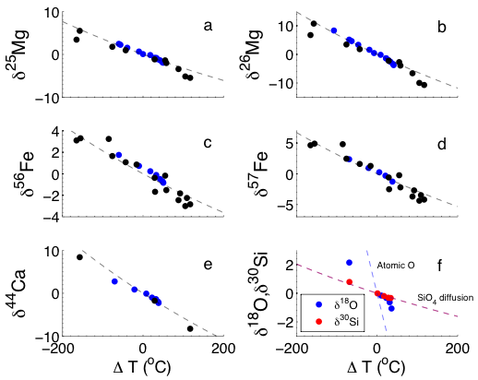
Diffusion Model Explains Both Elemental and Isotopic Fractionation in Thermal Gradients
One parameter (κ*) explains isotopic fractionation of Mg, Ca, Fe, and Si (?) and O(?)
Dominguez et al., Nature, 2011
Notes:
If we use the same k*, we predict the following isotopic fractionations. These are compared to observations

